Slide 1
Disambiguating Entity References within an Ontological Model
May 25, 2011
Joachim Kleb
Andreas Abecker
FZI Research Center for Information Technology
at the University of Karlsruhe Germany
WIR FORSCHEN FÜR SIE

Slide 2
Outline
1. Motivation
2. Idea
3. Algorithm
4. Related Work
5. Evaluation

Slide 3
Motivation: Entity
Entity:
  „a thing with distinct and independent existence“ (Oxford Dictonary)
Named Entity:
  „In the expression ‚Named Entity‘, the word ‚Named‘[...]“ refers „to those entities for which one or many rigid designators [...] stand for the referent“ (Satoshi Sekine)
Example:
Andreas is working at the FZI

Slide 4
Named Entity in an Ontology
„A named entity refers to a named class, a named individual or a named property“ (Manaf et al.)
Andreas is working at the FZI
Person
Company
Andreas
Person
Company
FZI
rdfs:label
rdfs:label
rdf:type
rdf:type
http://www.example.org/here#Andreas
ex:worksIn
http://www.example.org/here#FZI
Notes:
Named entity is a labeled ontology instance

Slide 5
Motivation: Ambiguity
Ambiguity
  “factual, explanatory prose, […]” and “[…] considered an error in reasoning or diction” (Encyclopedia Britannica)
Ontology Ambiguity
  Ambiguity concerning one class
  Ambiguity concerning multiple classes
  Ambiguity concerning T-Box and A-Box data
  Domain dependent and domain independent knowledge
Person
City
Rift
Wood
Person
Material
Metro as a tram → not part
of a geonames ontology
http://www.example.org/here#Metro
http://www.example.org/here#Andreas_1
http://www.example.org/here#Andreas_1
http://www.example.org/here#Black_Forest
http://www.example.org/here#Andreas_2
http://www.example.org/here#Andreas_2
http://www.example.org/here#wood

Slide 6
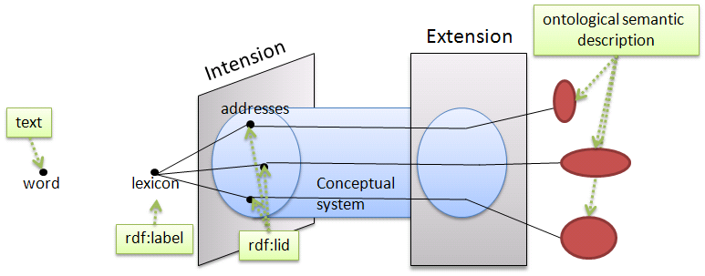
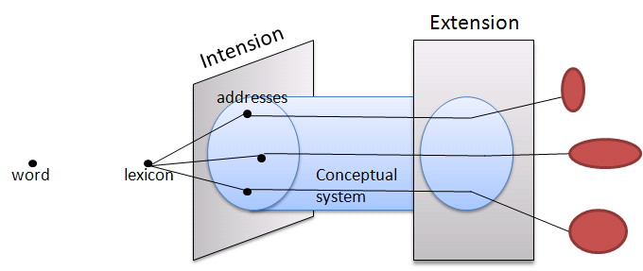
Model of Polysemy

Slide 7
Algorithm: Steps
Step 1:
  Retrieve entities from text
Step 2:
  Retrieve possible surrogates in the ontology
Step 3:
  Search for Steiner graphs containing at
  least one element from each surrogate set
Step 4:
  Ranking the resulting Steiner graphs

Slide 8
Algorithm: Steps
Andreas is working at the FZI.
Recently he wrote a paper with
his colleague Joachim .
Step 1:
  Retrieve entities from text
Done via Textprocessing Technique, e.g. Gazetteer
→ Andreas, FZI, Joachim

Slide 9



Algorithm: Steps
Step 2:
  Retrieve possible surrogates in the ontology
set of all initially given entity NLIs.
Ontology surrogates Si for a given entity
Identifier
Ontology:
ex:A1
ex:A2
ex:A3
ex:F1
ex:F2
ex:F3
ex:J1
:=
http://www.example.org/here#A2
http://www.example.org/here#A1
http://www.example.org/here#A3
“Andreas”,”Walter”,”AWA”,…
“Andreas”,”Nima”,”ANI”,…
“Andreas”,”AAB”,”Abecker”,…
http://www.example.org/here#A3
➔
i = “Andreas”
http://www.example.org/here#A2
http://www.example.org/here#A1

Slide 10
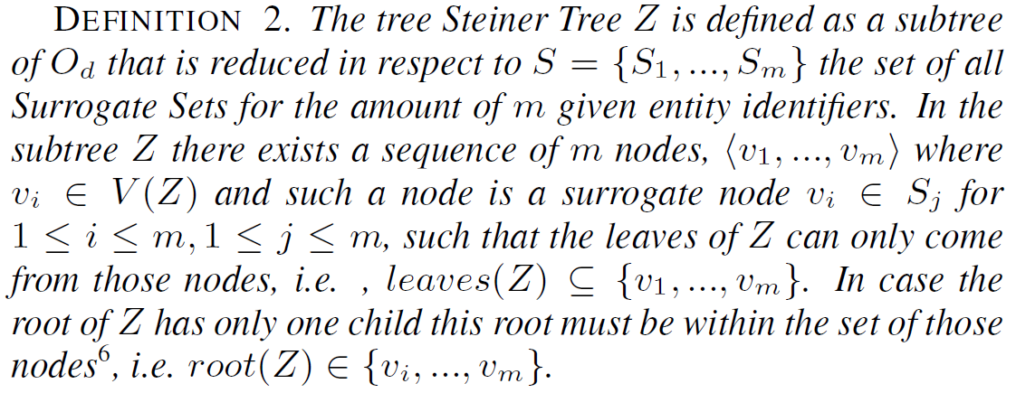
Algorithm: Steps
Step 3:
  Search for Steiner graphs containing at
  least one element from each surrogate set
Steiner Group Problem:
A)
J1
A3
F1
A1
F2

Slide 11
Algorithm: Relation to Idea
Surrogates for
Andreas
A)
J1
A3
Andreas is working at the FZI.
Recently he wrote a paper with
his colleague Joachim .
Ontology:
ex:A1
ex:A2
ex:A3
ex:F1
ex:F2
ex:F3
ex:J1
F1
A1
F2
Entity 1: “Andreas”
Entity 2: “FZI”
Entity 3: “Joachim”
B)
J1
A2
F1
F3
NLIs
Surrogates for
FZI
Surrogate for
Joachim
Ontology Element
Connector
Notes:
Hinweisen, das der Connector später noch erklärt wird.

Slide 12

Algorithm Step 3 & 4
Search for Steiner Graph & Ranking
Ranking
  The connector represents the node with the final aggregation of references for each entity identifier
  Top_{k} is calculated by the connector activations
  Further details are threshold factors, back propagation, assertion updates
Joachim = 0,8
FZI = 0,21
→ 2.01
J1
A3
A
F1
Joachim = 0,64
FZI = 0,17
Andreas = 0,13
→ 1,94
A1
F2

Slide 13
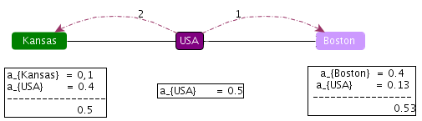
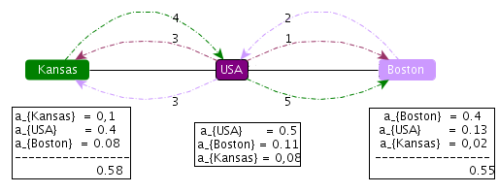
Extensions:
Bidirectional
Unidirectional:
Bidirectional:

Slide 14
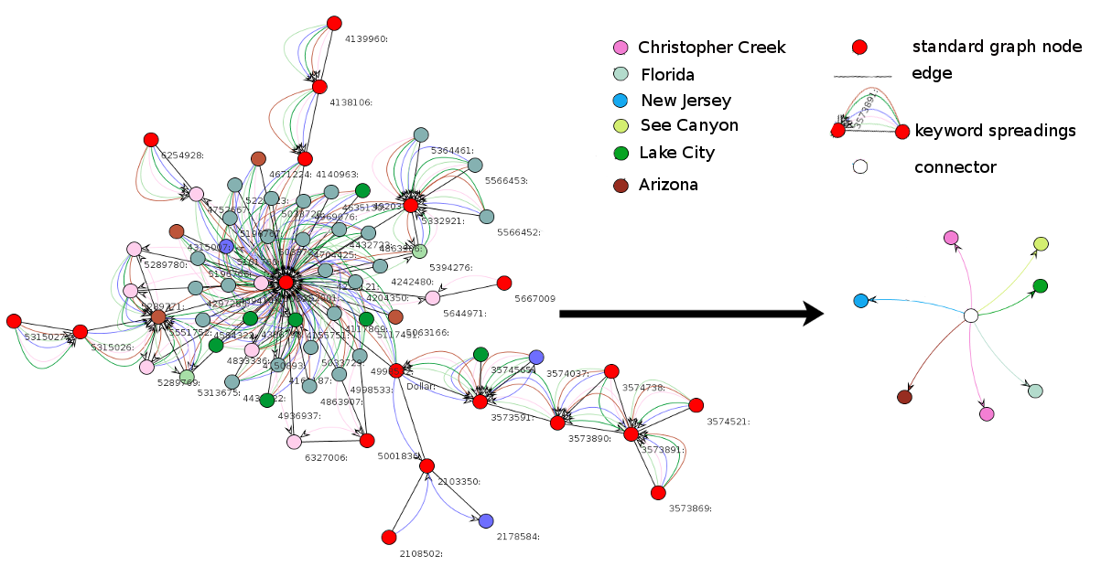
Extensions:
Local Coherence
Example Basis Algorithm:
“A wildfire in northern Arizona [...]. a fire north of Lake City in Florida. Flames remained about a mile from the community of Christopher Creek. The community is south of See Canyon [...]. Elsewhere New Jersey [...]”

Slide 15
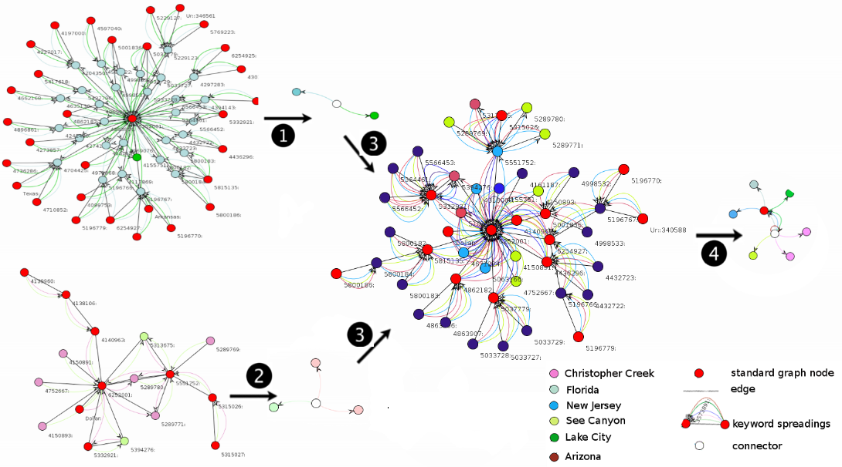
Extensions:
Local Coherence
Use of local coherence
“A wildfire in northern Arizona (context 1)
[...]. a fire north of Lake City in Florida. Flames remained about a mile (context 2)
from the community of Christopher Creek. The community is south of See Canyon (context 3)
[...]. Elsewhere New Jersey [...]” (context 4)

Slide 16
Extensions:
Reinfocement Learning
„Agent learns based on prior executed actions and uses this knowledge in order to evaluate and adapts its upcomming actions“ (Sutton&Barto1998)
Pre-execution Information:
  Entity Identifiers → Surrogate Sets Si
Information based on former
processed data
  Included Identifiers
  Retrieved items from surrogate sets
  → Recalculation of node importance, i.e. initial activation
Ontology:
ex:A1
ex:A2
ex:A3
ex:F1
ex:F2
ex:F3
ex:J1
Doc: 102
J1
A2
F1
F3

Slide 17
Ranking based on Coherence
General:
  The co-occurrence of entities in text is reflected by the possibility to retrieve paths between the ontology elements
  The significance for any resulting Steiner graph is given by the quality of its semantic coherence
Semantic Coherence:
  Cohesiveness (Graph): Information between every two entities is based on their mutual relations in the ontology graph. A result graph can be qualified:
    Quality of the relations between the entities (from non-existent to very tight)
  Expressivity (Node): Individual quality of a node in the graph. The quality is also adapted via back propagation.
    Initial activation
    Quality and amount
    of keyword connections
J1
A3
F1
A1
F2
Overall activation
Notes:
Keyword Zusammenhang herausarbeiten!

Slide 18
Evaluation
Textual input data collected from European Media Monitor
  News about natural disasters
Ontology using information from geonames.org. Adapted version concerning the original geonames.org ontology. Inclusion of relations.
Facts:
  169 documents
  Most ambiguous identifier in text was “San Antonio” with 1739 asserted ontology elements
  In average 37,06 possible ontology elements for each identifier in text

Slide 19


Evaluation
Measures:
  Recall:
  Precision:
Results:
Method | Recall | Precision | F-measure
Base | 76.03 | 68.71 | 71.09
Local coherence | 75.03 | 69.89 | 71.70
Reinforcement | 77.63 | 72.46 | 74.11
Bidirectional | 78.05 | 73.14 | 75.05
Notes:
Aussage zum Resultat:
Es war möglch in 97% aller Fälle das gesuchte Ergebnis zu bestimmen!
Jedoch waren die zurückgelieferten Resultsets pro entity, wie im Beispiel ebenfalls gezeigt, nicht immer eindeutig, was die Precission auf 48% senkte.

Slide 20
Previous approaches
Graph based algorithms
  Different algorithms for disambiguation also with spreading activation but mainly based on linguistic measure and natural language analysis mostly independent of ontologies
Ontology-element disambiguation
  Approaches also focus on NLP. Many based on machine-learning requiring training data
Keyword search on graphs
  Focus on 2-3 keywords. Problem of ambiguity not main focus
Our approach:
  Focus on the structure and specific properties of an ontology and a generic algorithm for disambiguation using semantic relations between entities
  No supervised learning phase necessary
  Based on co-occurrence information
Notes:
Bringe ein paar Paper examples pro approach um deine Ansichten zu untermauern
Veronis und Ide: SA disambiguate the sense in a thesaurus
1.1 Tsatsaroni in Wordnet (glosses)
1.2. Malaise for tv programm annotation
1.3. Bhatarachy & Rada
Nguyen Vector Analysis
2. 1. IdRank (Garcia)
2.2. Hassel DBLP
3. Banks
3.1 Kacholia
3.2. Blinks
3.3. Kasneki

Slide 21
Conclusion
Motivation
  Ambiguity causes failures in reasoning and diction
Algorithm
  Steiner graphs reflect co-occurrence of entities similar to their co-occurrence in text
  Spreading activation allows for a weighted and priority base exploration of graphs
Evaluation
  Our algorithm achieved promising precision and recall values
Outlook
  Further points are the use of conceptual relations and the correlation between linguistic and ontological analysis concerning ambiguity resolution
Notes:
Schlüsselwörter hervorheben
Kollege nachschauen

Slide 22
Thanks for your attention!
Questions?

Slide 24
Motivation: Ambiguity
W3C definitions:
  Uniform Resource Identifier: “Two RDF URI references are equal if and only if they compare as equal, character by character, as Unicode strings”
  Label represented by Literal: “The strings of the two lexical forms compare equal, character by character.”
Consequences:
  Ambiguity arises as a fundamental problem based on the above definitions
Andreas
Andreas
Unique !
http://www.example.org/here#Andreas
Ambiguous !
…
http://www.example.org/here#Andreas
http://www.example.org/here#Andreas
http://www.example.org/here#Andreas_1
rdfs:label
rdfs:label
http://www.example.org/here#Andreas_2
Andreas
Andreas
rdfs:label
…
Notes:
Include NLI → Natural language identifier here!
rdf:id for uris and rdf:label for literals (may include SKOS with pref-label and alter-label)

Slide 25
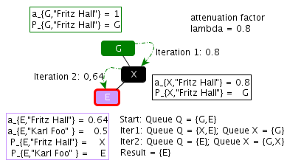
Example: Algorithm

Slide 26
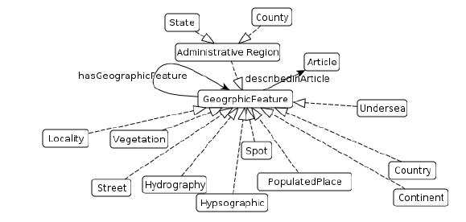
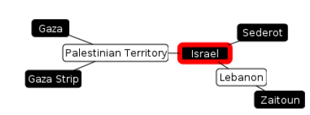
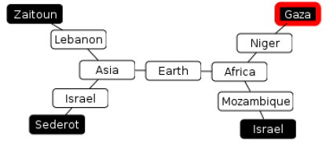
Evaluation
Ontology
Possible Result Graphs

Slide 27
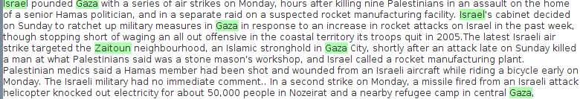
Example: Text Document
Text Document
Possible Result Graphs

