Slide 1
Utilising Linked Open Data in Applications
Dr. Michael Hausenblas and Dr. Sören Auer
Tutorial at International Conference on Web Intelligence, Mining and Semantics Thursday, 26 May 2011, Sogndal, Norway

Slide 2
Outline
Linked Data 101
The Linked Open Data cloud
Discovery and Access of Linked Data
Querying Linked Data

Slide 3
Organisational Notes
Michael will do the first session, Sören will do the second session
If you have questions:
Use WebIRC back-channel
Go to http://webchat.freenode.net/
Join the #wims-tutorial channel
Tweet about the question using the #wims-tutorial hash tag
Drop me a mail at michael.hausenblas@deri.org

Slide 4
Linked Data 101

Slide 5
Orientation

Slide 6
Linked Data 101
Linked Data provides a standardised API for:
Data and metadata discovery
Data integration
Distributed query

Slide 7
Linked Data principles
Use URIs to identify the “things” in your data
Use http:// URIs so people (and machines) can look them up on the web
When a URI is looked up, return a description of the thing (in RDF format)
Include links to related things
http://www.w3.org/DesignIssues/LinkedData.html

Slide 8
Linked Data principles
They are principles, not implementation advices
Not humans or machines but humans and machines!
Content negotiation (e.g. HTML and RDF/XML)
HTML+ RDFa
Metcalfe’s Law http://en.wikipedia.org/wiki/Metcalfe%27s_law

Slide 9
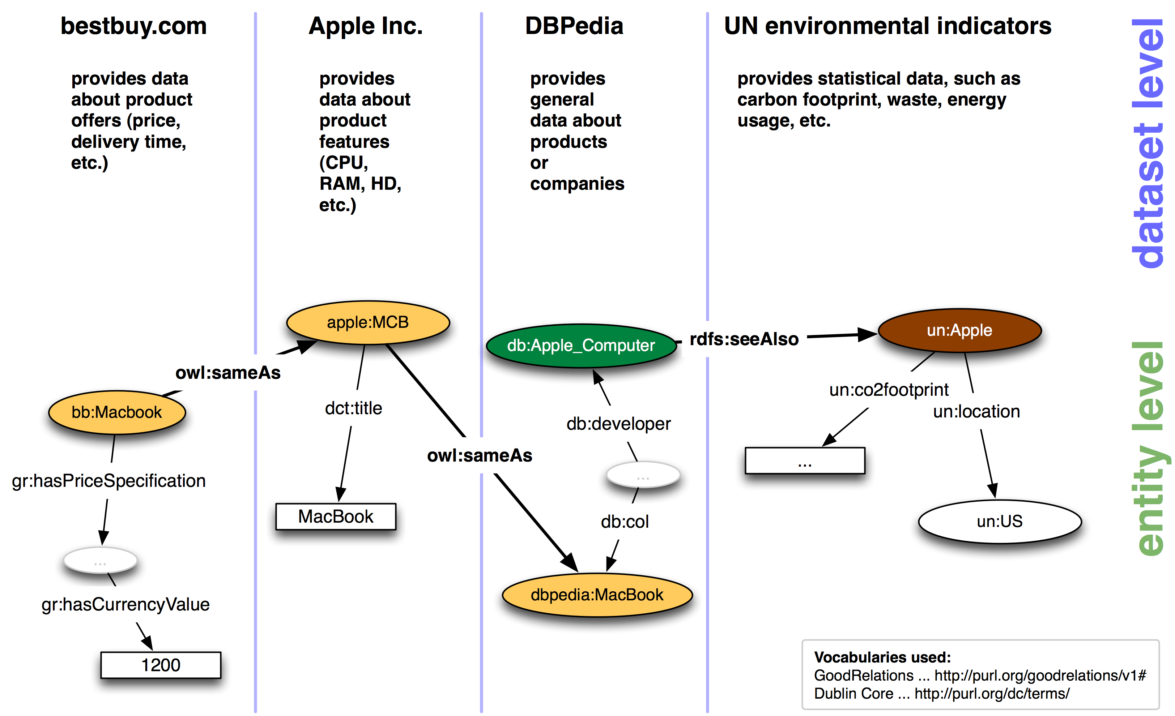
Linked Data example
9

Slide 10
HTTP URIs
A Uniform Resource Identifier (URI) is a compact sequence of characters that identifies an abstract or physical resource. [RFC3986]
Syntax
URI = scheme ":" hier-part [ "?" query ] [ "#" fragment ]
Example
foo://example.com:8042/over/there?name=ferret#nose
\_/ \_________________/\_________/ \__________/ \__/
| | | | |
scheme authority path query fragment

Slide 11
HTTP URIs
Don’t confuse scheme with protocol
Scheme: defines URI layout and semantics
Protocol: defines communication means between endpoints (such as HTTP or FTP)
URI resolution (as of RFC3986):
STEP OUTPUT BUFFER INPUT BUFFER
1 : /a/b/c/./../../g
2E: /a /b/c/./../../g
2E: /a/b /c/./../../g
2E: /a/b/c /./../../g
2B: /a/b/c /../../g
2C: /a/b /../g
2C: /a /g
2E: /a/g

Slide 12
HTTP URIs
URI references
An RDF URI reference is a Unicode string does not contain any control characters (#x00 - #x1F, #x7F-#x9F) and would produce a valid URI character sequence representing an absolute URI when subjected to an UTF-8 encoding along with %-escaping non-US-ASCII octets.
Qualified Names (QNames)
XML’s way to allow namespaced elements/attributes as of QName = Prefix ‘:‘ LocalPart
Compact URIs (CURIEs)
Generic, abbreviated syntax for expressing URIs

Slide 13
HTTP
The Hypertext Transfer Protocol (HTTP) is an application-level protocol for distributed, collaborative, hypermedia information systems.
It is a generic, stateless, protocol which can be used for many tasks beyond its use for hypertext, such as name servers and distributed object management systems, through extension of its request methods, error codes and headers. A feature of HTTP is the typing and negotiation of data representation, allowing systems to be built independently of the data being transferred.

Slide 14
HTTP
HTTP messages consist of requests from client to server and responses from server to client
Set of methods is predefined
GET
POST
PUT
DELETE
HEAD
(OPTIONS)

Slide 15
HTTP
Status codes
Informational 1xx, provisional response, (100 Continue)
Successful 2xx, request successfully received, understood, and accepted (201 Created)
Redirection 3xx, further action needs to be taken by user agent to fulfill the request (301 Moved Permanently)
Client Error 4xx, client erred (405 Method Not Allowed)
Server Error 5xx, server encountered an unexpected condition (501 Not Implemented)

Slide 16
HTTP
GET /html/rfc2616 HTTP/1.1
Host: tools.ietf.org
User-Agent: Mozilla/5.0
Accept: text/html,application/xhtml+xml,application/xml;q=0.9,*/*;q=0.8
HTTP/1.x 200 OK
Date: Thu, 05 Mar 2009 08:17:33 GMT
Server: Apache/2.2.11
Content-Location: rfc2616.html
Last-Modified: Tue, 20 Jan 2009 09:16:04 GMT
Content-Type: text/html; charset=UTF-8
REQUEST
RESPONSE

Slide 17
HTTP
Content Negotiation: selecting representation for a given response when multiple representations available
Three types of CN: server-driven, agent-driven CN, transparent CN
Example:
curl -I -H "Accept: application/rdf+xml" http://dbpedia.org/resource/Galway
HTTP/1.1 303 See Other
Content-Type: application/rdf+xml
Location: http://dbpedia.org/data/Galway.rdf

Slide 18
HTTP
Caching (see Cache–Control header field) is essential for scalability http://webofdata.wordpress.com/2009/11/23/linked-open-data-http-caching/
HTTPbis IETF WG chaired by Mark Nottingham, mainly about: patches, clarifications, deprecate non-used features, documentation of security properties

Slide 19
REST - HTTP
Representational State Transfer (REST)
resource intended conceptual target of a hypertext reference
resource identifier URL, URN
representation HTML document, JPEG image
representation media type, last-modified time
metadata
resource source link, alternates, vary metadata
control data if-modified-since, cache-control
http://www.ics.uci.edu/~fielding/pubs/dissertation/top.htm http://webofdata.wordpress.com/2009/10/09/linked-data-for-restafarians/

Slide 20
RDF
A data model - directed, labeled graph
Triple: (subject predicate object)
subject … URIref or bNode
predicate … URIref
object … URIref or bNode or literal

Slide 21
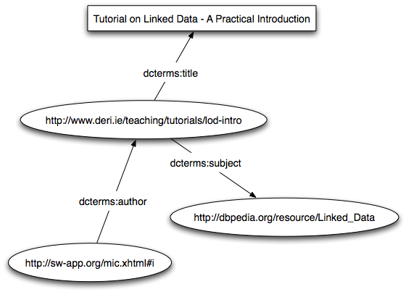
RDF

Slide 22
Vocabularies
Schema layer of RDF
Defines terms (classes and properties)
Typically RDFS or OWL family
Common vocabularies:
Dublin Core, SKOS
FOAF, SIOC, vCard
DOAP
Core Organization Ontology
VoID
http://www.slideshare.net/prototypo/introduction-to-linked-data-rdf-vocabularies

Slide 23
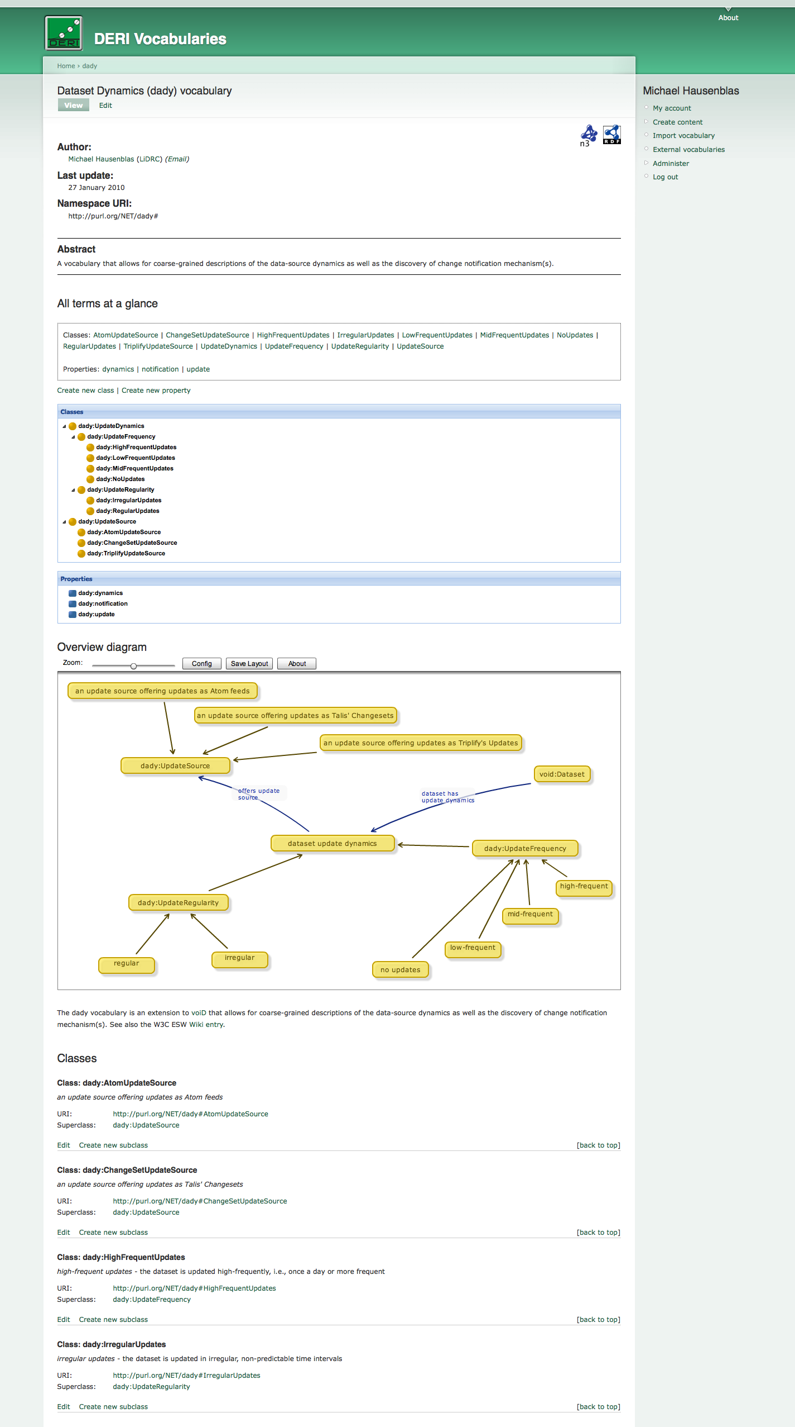
Vocabulary Management
http://vocab.deri.ie/
Neologism - Drupal-based RDF-S vocabulary editor and publishing system:
Collaborativelly creating and maintaining RDFS vocabularies
Making the vocab available for humans (HTML, graph) and machines (RDF/XML, Turtle)
Importing external vocabularies
Working with external namespaces such as via PURL.org, etc.
More at http://neologism.deri.ie/

Slide 24
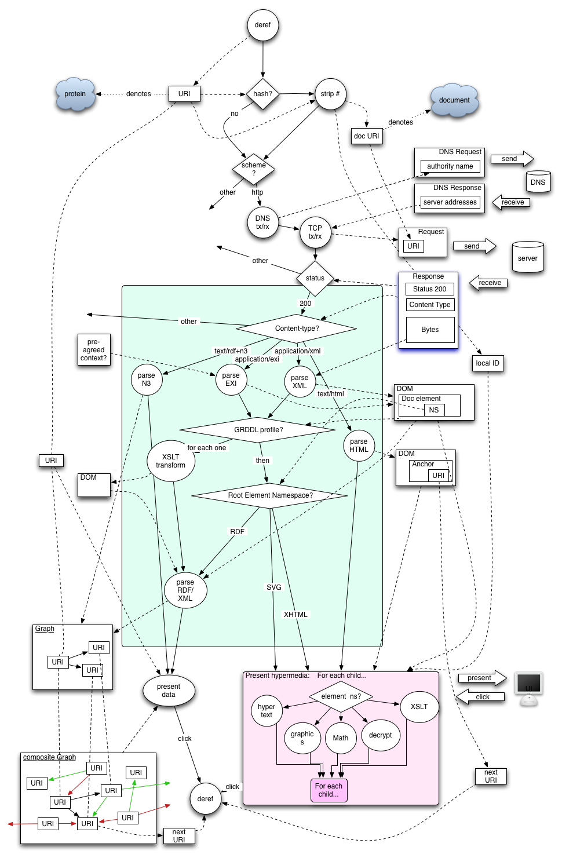
Web's Standard Retrieval Algorithm
parse URI and find HTTP protocol
look up DNS name to determine the associated IP address
open a TCP stream to port 80 at the IP address determined above
format an HTTP GET request for resource and sends that to the server
read response from the server
from the status code (200) determine that a representation of the resource is available
inspect the returned Content-Type
pass the entity-body to its HTML rendering engine
http://www.w3.org/2001/tag/doc/selfDescribingDocuments

Slide 25
The Linked Open Data cloud

Slide 26
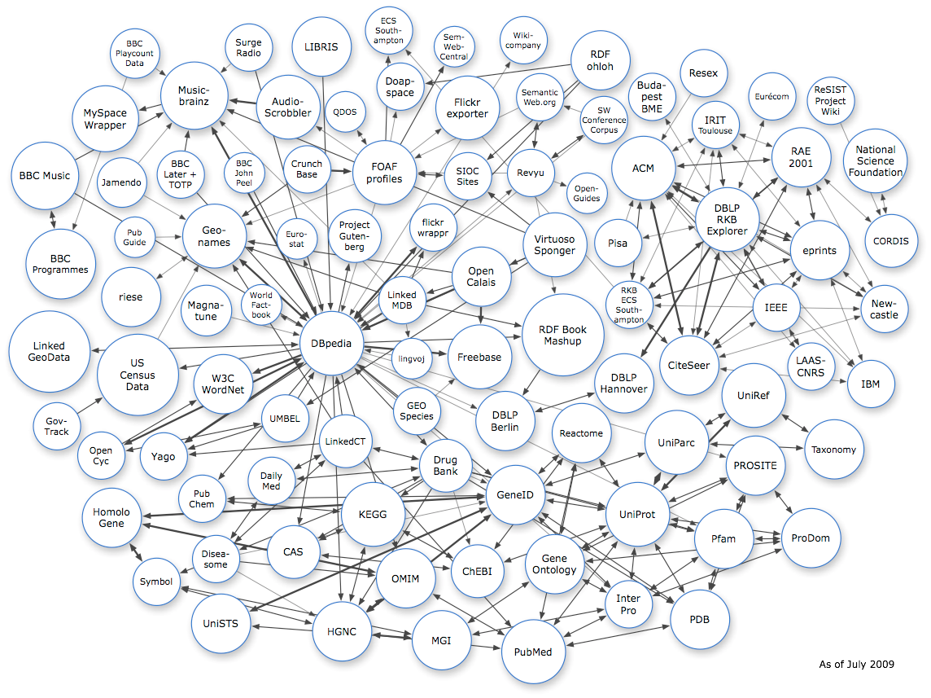
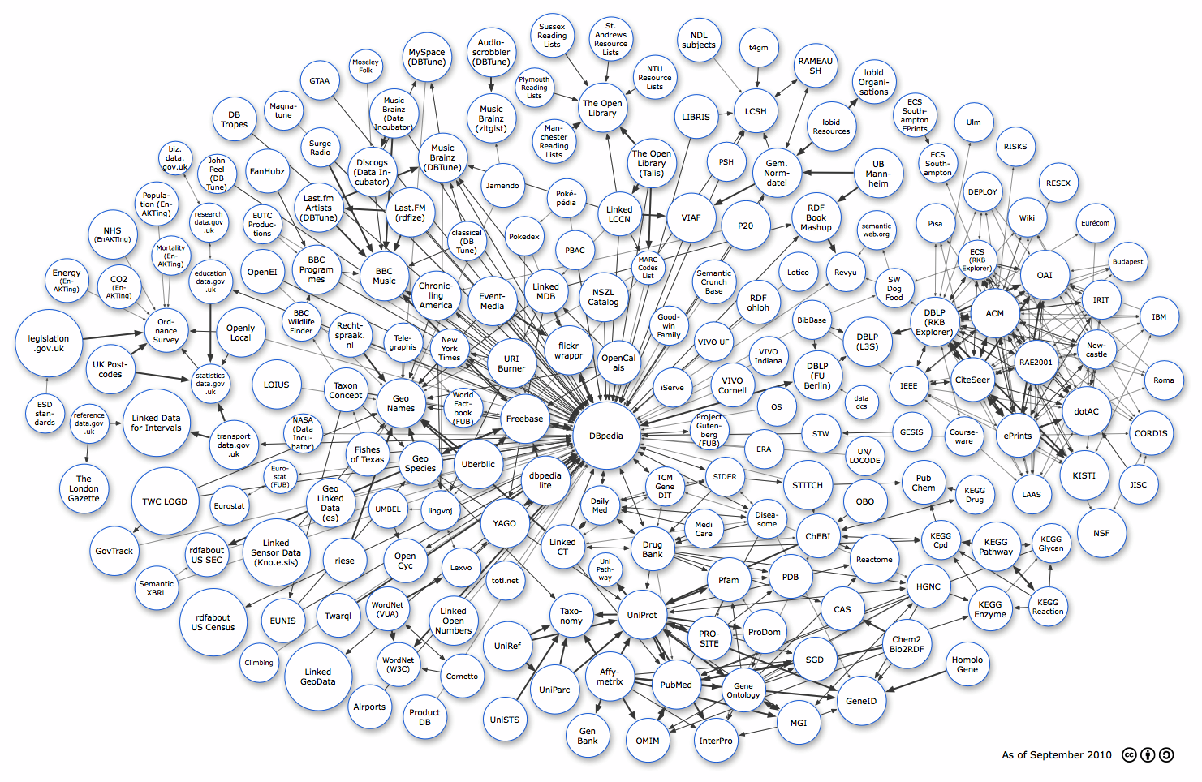
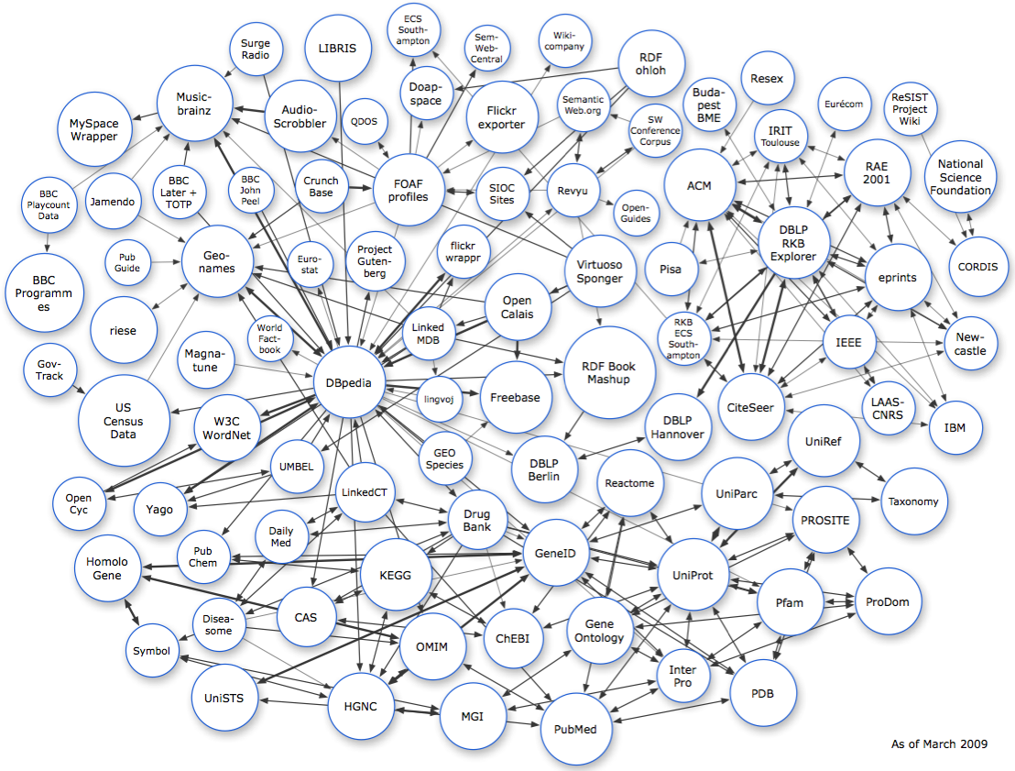
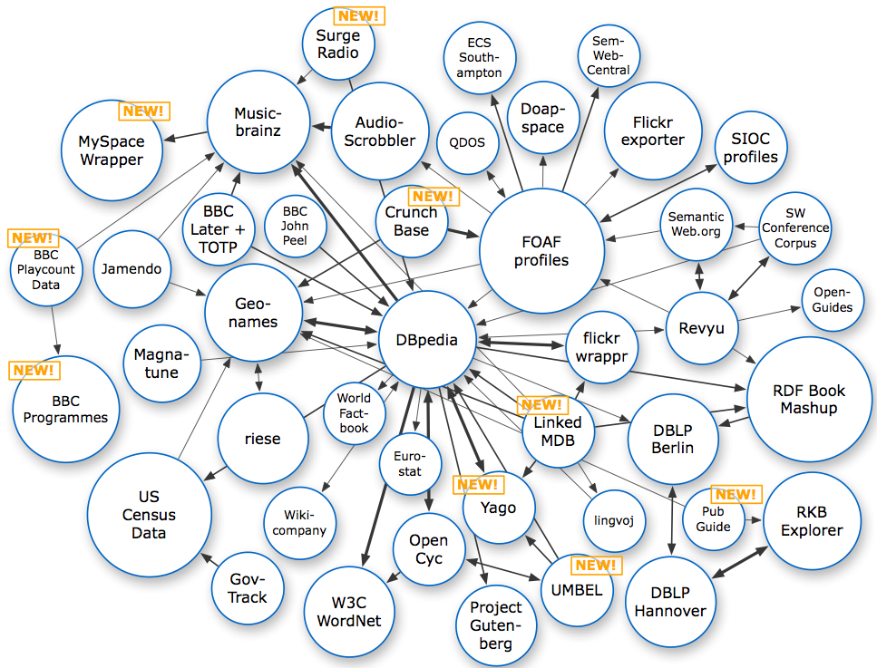
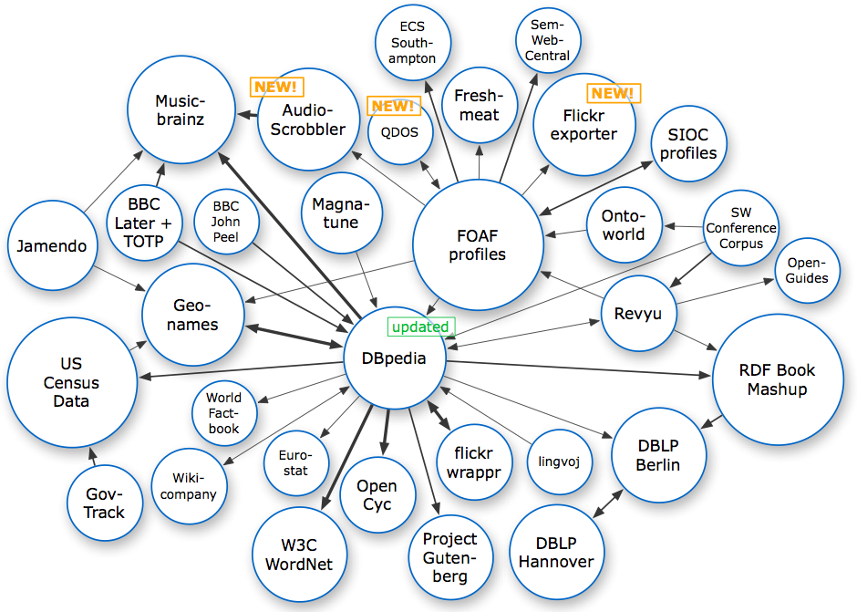
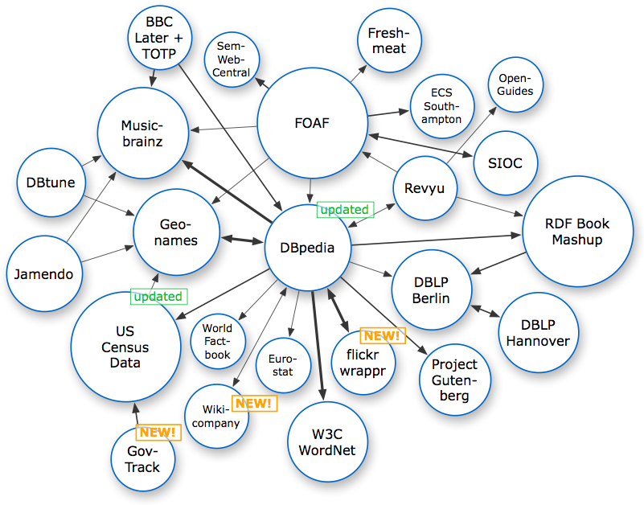
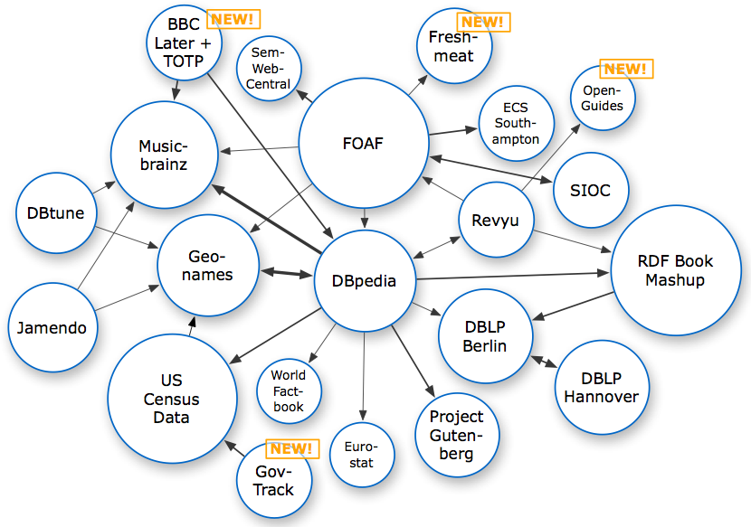
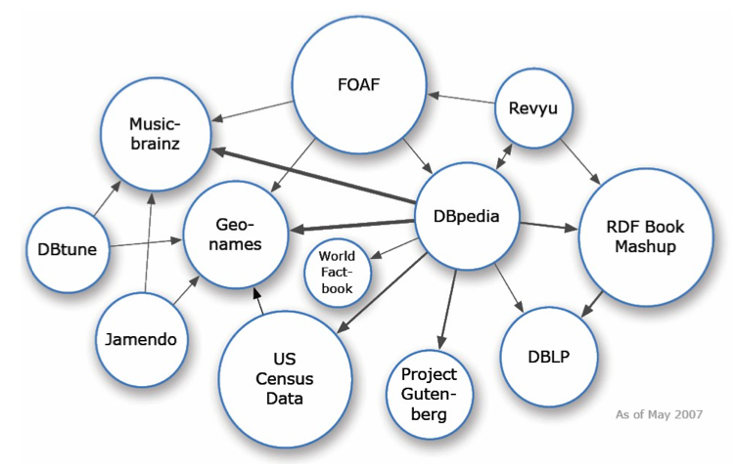
Linked Open Data cloud
2010
2008
2009
2007
2008
2008
2009
2008
26

Slide 27
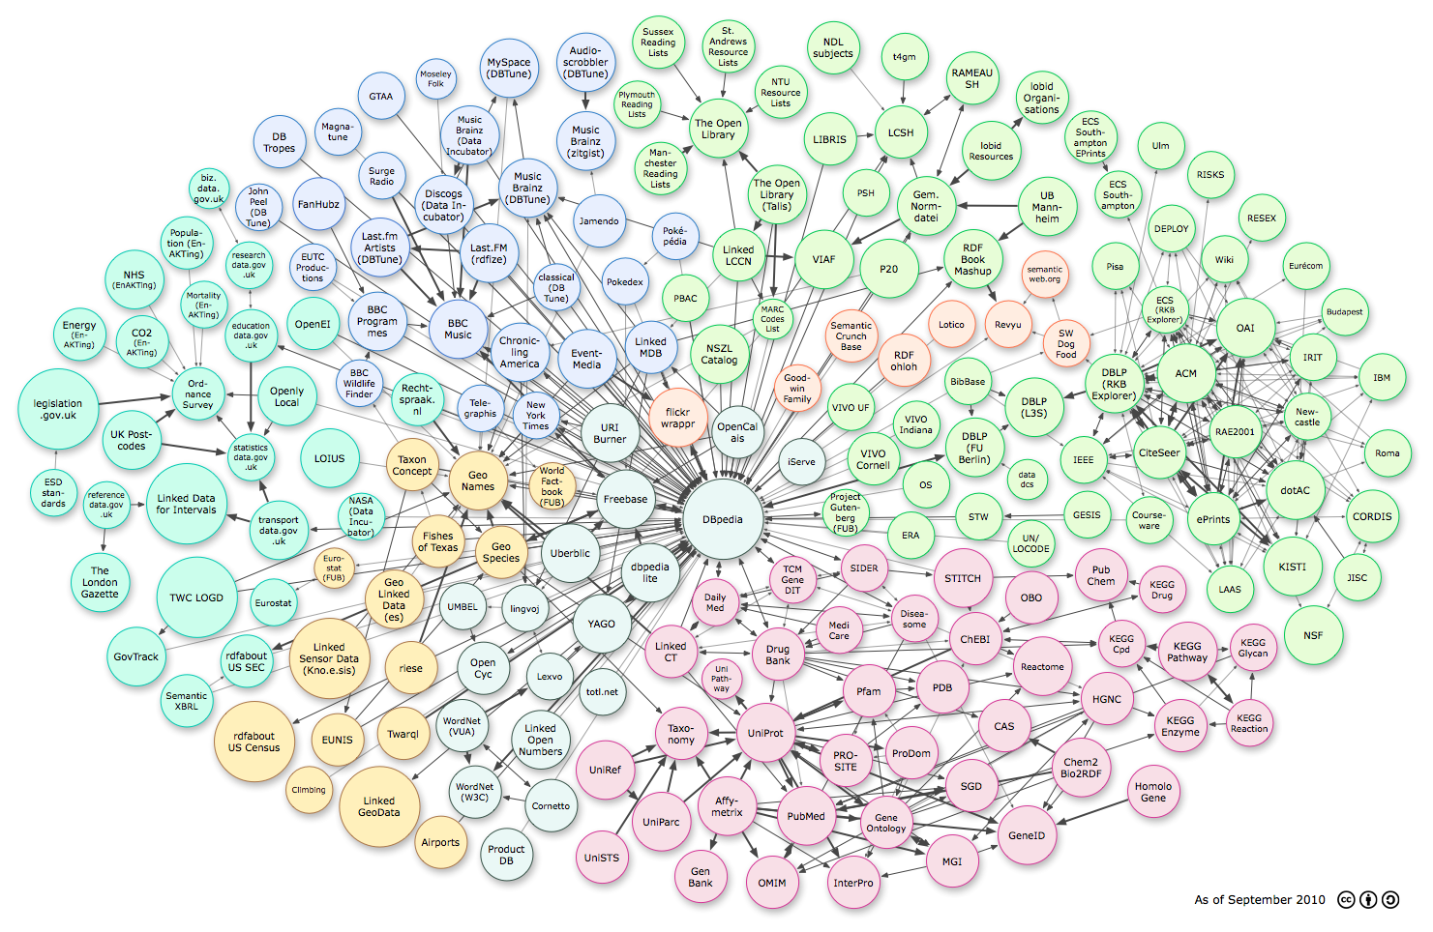
Linked Open Data cloud
Media
User-generated
Government
Publications
Cross-domain
Geo
Life sciences
http://lod-cloud.net/

Slide 28
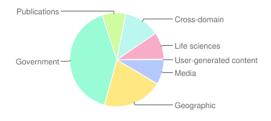
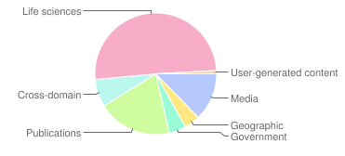
LOD cloud stats
triples distribution
links distribution
http://lod-cloud.net/state/

Slide 29
http://thinkquarterly.co.uk/01-data/a-data-state-of-mind/
Hans Rosling
‘database hugging disorder’
Notes:
But there is a problem to overcome.
Who of you knows this fellow here? I’d like to think of him as a data superstar. His name is Hans Rosling and he is a Swedish guy who deals mainly with statistical data.
He coined a term for this problem: the so called database hugging disorder.
Meaning: people and institutions, even if they are aware of their data, tend to not share it or hide it in applications.

Slide 30
TimBL’s 5-star plan for open data
★ Make your data available on the Web under an open license
★★ Make it available as structured data (Excel sheet instead of image scan of a table)
★★★ Use a non-proprietary format (CSV file instead of an Excel sheet)
★★★★ Use Linked Data format (URIs to identify things, RDF to represent data)
★★★★★ Link your data to other people’s data to provide context
More: http://lab.linkeddata.deri.ie/2010/star-scheme-by-example/

Slide 31
Why going for the 5th star?
Central Contractor Registration (CCR)
Geonames
http://webofdata.wordpress.com/2011/05/22/why-we-link/

Slide 32
Effort distribution
Fix Overall Data Integration Effort

Slide 33
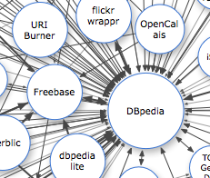
Datasets
A dataset is a set of RDF triples that are published,
maintained or aggregated by a single provider

Slide 34
Linksets
An RDF link is an RDF triple whose subject and object are described in different datasets
A linkset is a collection of such RDF links between two datasets

Slide 35
Describing Datasets - VoID
General dataset metadata
Access metadata
Structural metadata
Describing linksets
Deployment and discovery of voiD files
http://www.w3.org/TR/void/

Slide 36
General dataset metadata
Dataset homepage
Publisher
Title and description
Categorisation
Licensing
Technical features

Slide 37
General dataset metadata
:DBpedia a void:Dataset ;
dcterms:title "DBPedia” ;
dcterms:description "RDF data extracted from Wikipedia” ;
dcterms:contributor :FU_Berlin ;
dcterms:source <http://dbpedia.org/resource/Wikipedia> ;
void:feature <http://www.w3.org/ns/formats/RDF_XML> ;
dcterms:modified "2008-11-17"^^xsd:date .
:Geonames a void:Dataset ;
dcterms:subject <http://dbpedia.org/resource/Location> .
:GeoSpecies a void:Dataset ;
dcterms:license <http://creativecommons.org/licenses/by-sa/3.0/us/> .

Slide 38
Access metadata
SPARQL endpoints
RDF data dumps
Root resources
URI lookup endpoints
OpenSearch description documents

Slide 39
Access metadata
:exampleDS void:Dataset ;
void:sparqlEndpoint <http://example.org/sparql> ;
void:dataDump <http://example.org/dump1.rdf> ;
void:uriLookupEndpoint <http://api.example.org/search?qt=term> .

Slide 40
Structural metadata
Provides high-level information about the schema and internal structure of a dataset and can be helpful when exploring or querying datasets:
Example resources
Patterns for resource URIs
Vocabularies
Dataset partitions
Statistics

Slide 41
Structural metadata
:DBpedia a void:Dataset;
void:exampleResource <http://dbpedia.org/resource/Berlin> .
:LiveJournal a void:Dataset;
void:vocabulary <http://xmlns.com/foaf/0.1/> .
:DBpedia a void:Dataset;
void:classPartition [
void:class foaf:Person;
void:entities 312000;
];
void:propertyPartition [
void:property foaf:name;
void:triples 312000;
];
.

Slide 42
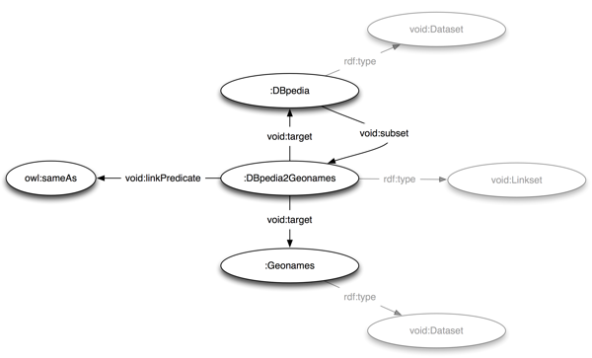
Describing linksets

Slide 43
Describing linksets
:DBpedia a void:Dataset ;
void:subset :DBpedia2Geonames .
:Geonames a void:Dataset .
:DBpedia2Geonames a void:Linkset ;
void:target :DBpedia ;
void:target :Geonames ;
void:linkPredicate owl:sameAs .

Slide 44
Deployment and discovery
Choosing URIs for datasets
Publishing a VoID file alongside a dataset
Turtle
RDFa
SPARQL Service Description Vocabulary http://www.w3.org/TR/sparql11-service-description/
Discovery (well-known URI), based on of RFC5758], registered with IANA http://www.example.com/.well-known/void

Slide 45
Discovery and Access of Linked Data

Slide 46
Linked Data Life-cycle
6. Use cases
5. Integration
4. Discovery
3. Publishing
2. Modeling
1. Data awareness

Slide 47
Data awareness
To raise awareness regarding government data in Ireland and establish a community around open data access and usage.
6. Use cases DERI in-house CSO/schools pilot
5. Integration LATC Sig.ma
4. Discovery VoID/DCAT Sindice CKAN
3. Publishing Google Refine plug-in RDB2RDF/D2R
2. Modeling Neologism DataCube prefix.cc
1. Data awareness opendata.ie LOD cloud

Slide 48
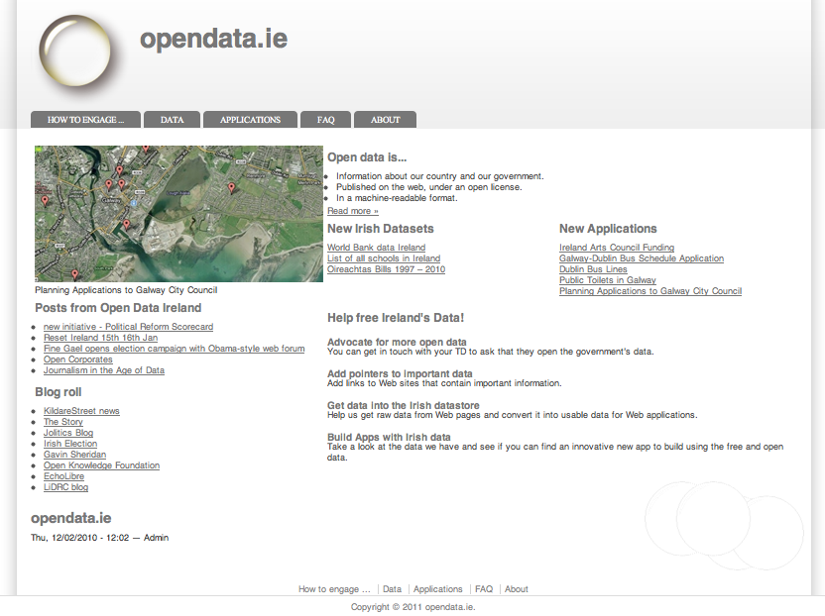
Data awareness
http://opendata.ie
Community building

Slide 49
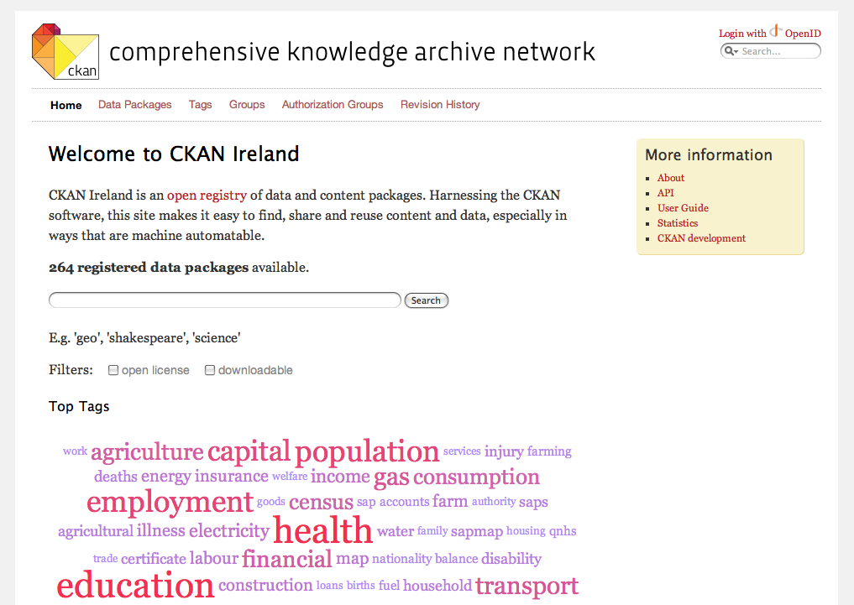
Data awareness
http://ie.ckan.net
Irish data catalog

Slide 50
Modeling
6. Use cases DERI in-house CSO/schools pilot
Model and share vocabularies on the Web (Drupal plug-in). Exposes vocabulary both human-friendly and machine-readable (RDF/XML, N3).
5. Integration LATC Sig.ma
4. Discovery VoID/DCAT Sindice CKAN
3. Publishing Google Refine plug-in RDB2RDF/D2R
2. Modeling Neologism DataCube prefix.cc
1. Data awareness opendata.ie LOD cloud

Slide 51
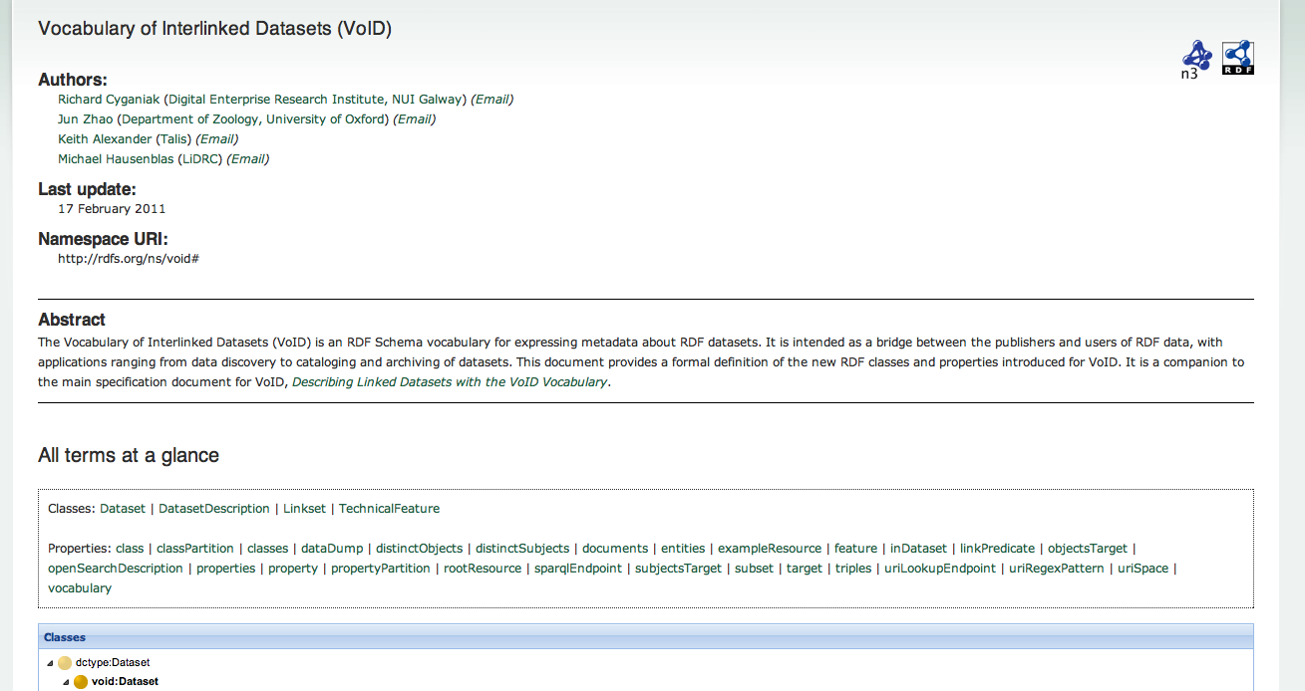
Modeling
http://vocab.deri.ie
http://neologism.deri.ie

Slide 52
Publishing
6. Use cases DERI in-house CSO/schools pilot
Mapping and exporting data of Google Refine projects in RDF format.
5. Integration LATC Sig.ma
4. Discovery VoID/DCAT Sindice CKAN
3. Publishing Google Refine plug-in RDB2RDF/D2R
2. Modeling Neologism DataCube prefix.cc
1. Data awareness opendata.ie LOD cloud

Slide 53
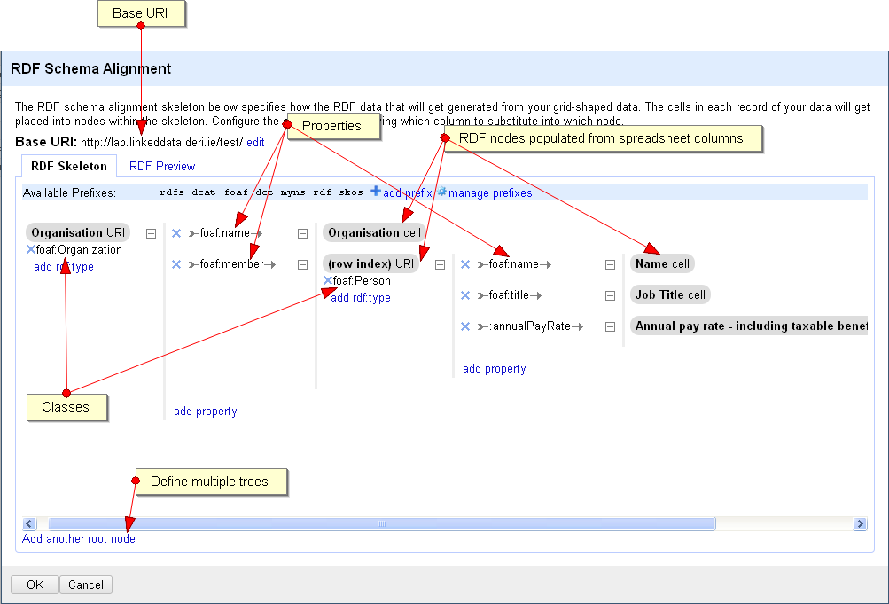
Publishing
http://lab.linkeddata.deri.ie/2010/grefine-rdf-extension/

Slide 54
Discovery
6. Use cases DERI in-house CSO/schools pilot
Describe and explore LOD datasets with VoID.
5. Integration LATC Sig.ma
4. Discovery VoID/DCAT Sindice CKAN
3. Publishing Google Refine plug-in RDB2RDF/D2R
2. Modeling Neologism DataCube prefix.cc
1. Data awareness opendata.ie LOD cloud

Slide 55
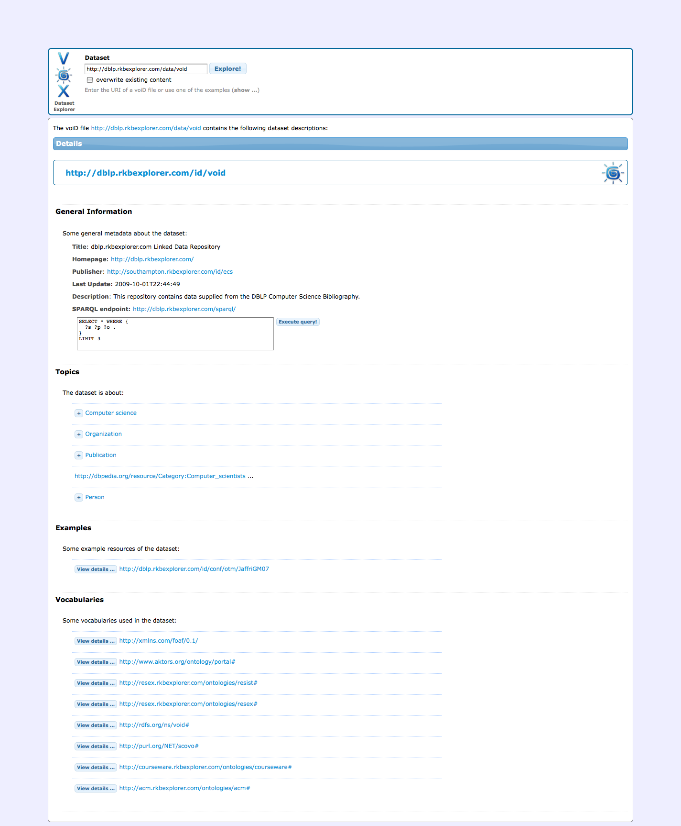
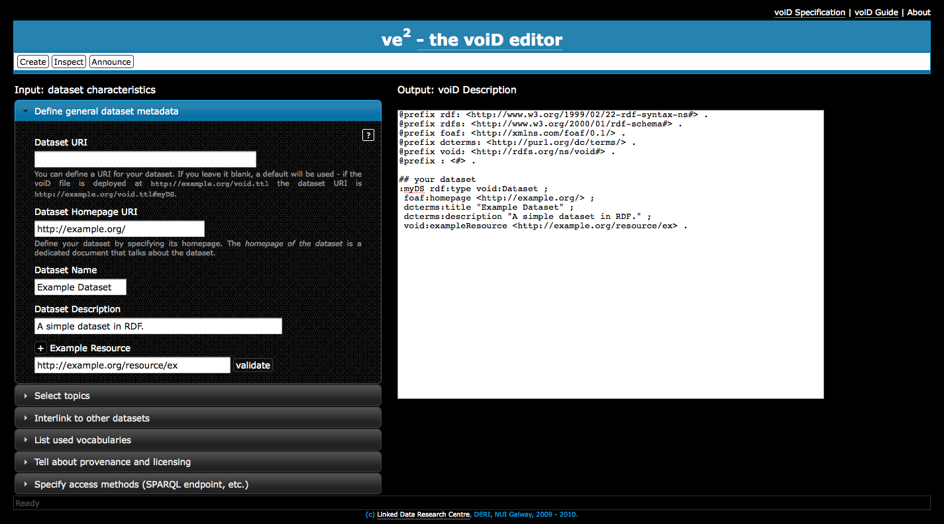
Discovery
http://lab.linkeddata.deri.ie/vox/
VoID editor
http://lab.linkeddata.deri.ie/ve2/
More: http://www.w3.org/TR/void/
VoID explorer

Slide 56
Integration
6. Use cases DERI in-house CSO/schools pilot
24/7 Interlinking platform to enrich the LOD cloud and foster new applications.
5. Integration LATC Sig.ma
4. Discovery VoID/DCAT Sindice CKAN
3. Publishing Google Refine plug-in RDB2RDF/D2R
2. Modeling Neologism DataCube prefix.cc
1. Data awareness opendata.ie LOD cloud

Slide 57
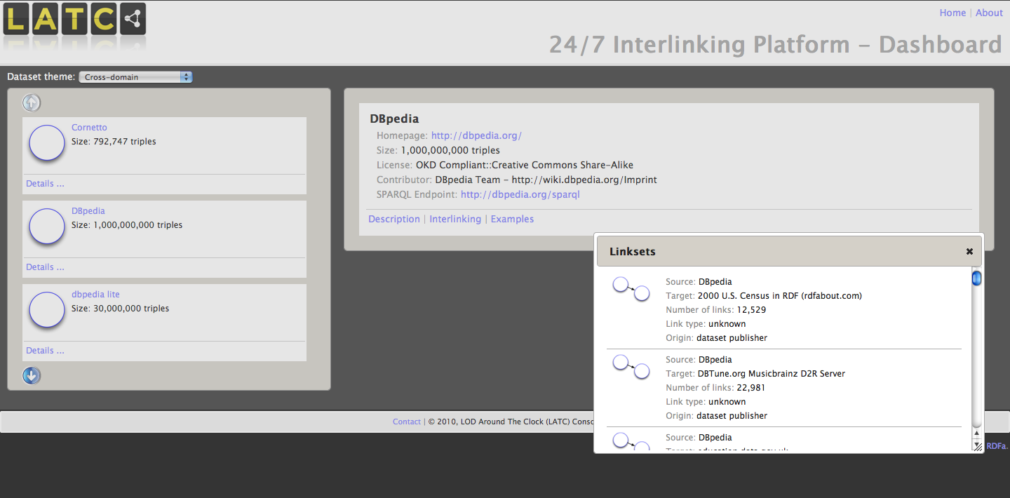
Integration
http://latc-project.eu

Slide 58
Use Cases
Understand DERI as an enterprise and demo how to integrate a range of data sources (rooms, groups, location, people profiles).
6. Use cases DERI in-house CSO/schools pilot
5. Integration LATC Sig.ma
4. Discovery VoID/DCAT Sindice CKAN
3. Publishing Google Refine plug-in RDB2RDF/D2R
2. Modeling Neologism DataCube prefix.cc
1. Data awareness opendata.ie LOD cloud

Slide 59
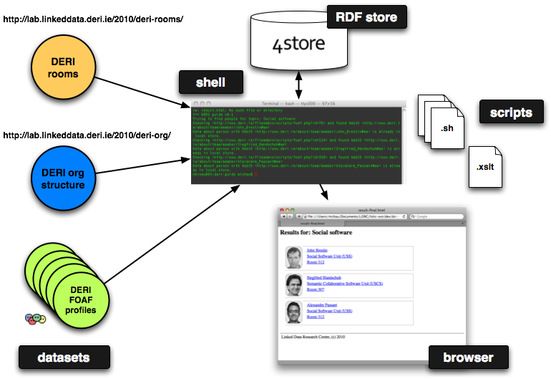
Use Cases
DERI Guide

Slide 60
Consumption - Essentials
Linked Data provides for a global data-space with a uniform API (due to RDF as the data model)
Access methods
Dereference URIs via HTTP GET (RDF/XML, RDFa, etc.)
SPARQL (‘the SQL of RDF’)
Data dumps (RDF/XML, etc.)

Slide 61
Consumption - Technologies
Linked Data access mechanisms widely supported
all major platforms and languages (HTTP interface & RDF parsing), such as Java, Python, PHP, C/C++/.NET, etc.
Command line tools (curl, rapper, etc.)
Online tools
http://redbot.org/ (HTTP/low-level)
http://sindice.com/developers/inspector (RDF/data-level)
Structured query: SPARQL (more later)

Slide 62
Consumption - Technologies
Distributed setup → need for central point of access (indexer, aggregator)
Sindice, an index of the Web of Data
http://sindice.com/
Sig.ma, Web of Data aggregator & browser
http://sig.ma/
Relationship discovery
http://relfinder.semanticweb.org/

Slide 63
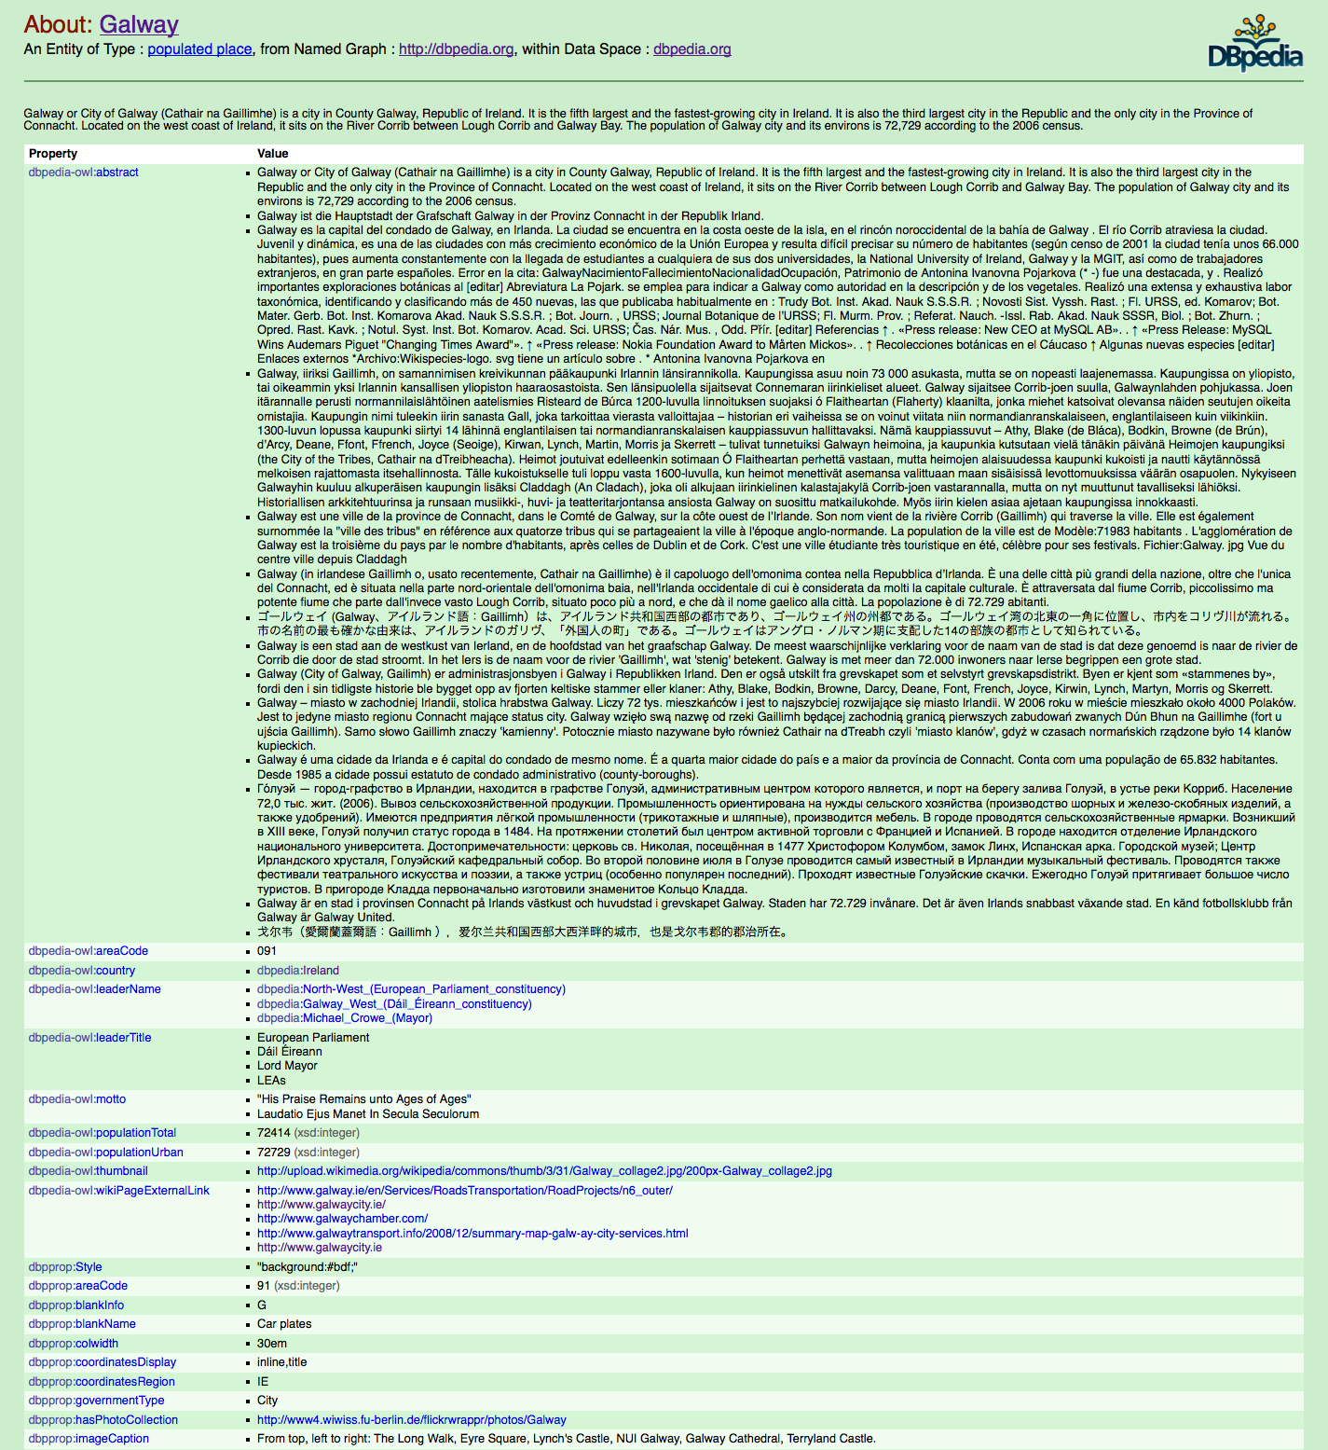
Technologies – FYN
http://dbpedia.org/resource/Galway
63

Slide 64
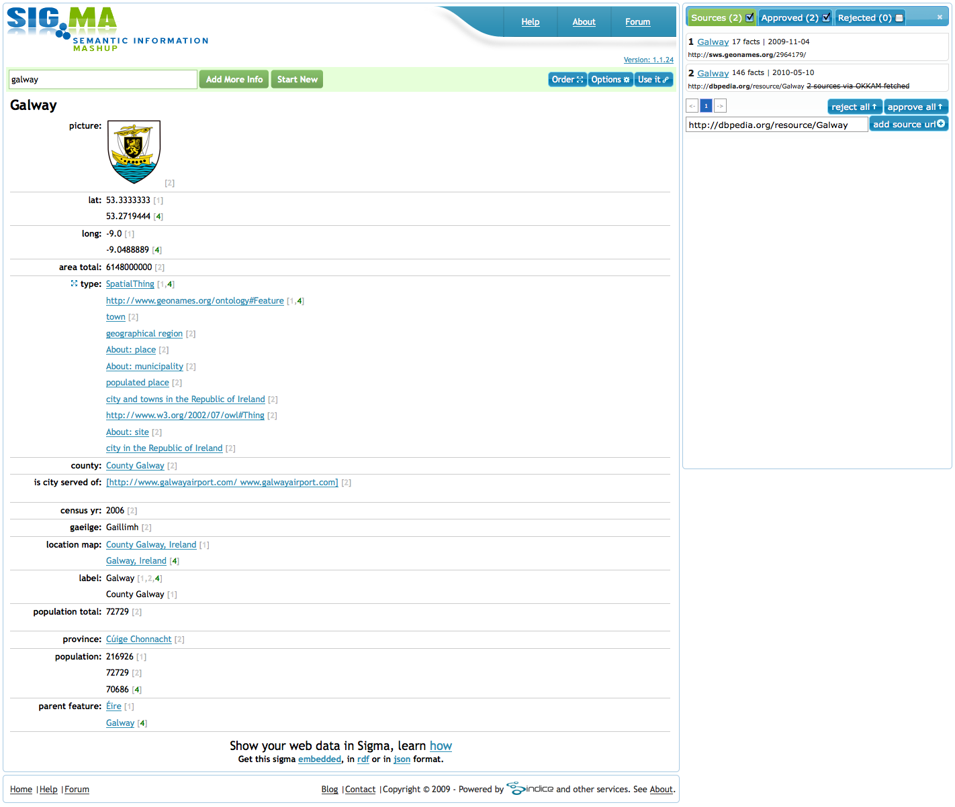
Technologies – Sig.ma
Sig.ma is a Web of Data platform enabling entity visualisation and consolidation both for humans and machines (API)
http://sig.ma/search?q=Galway
64

Slide 65
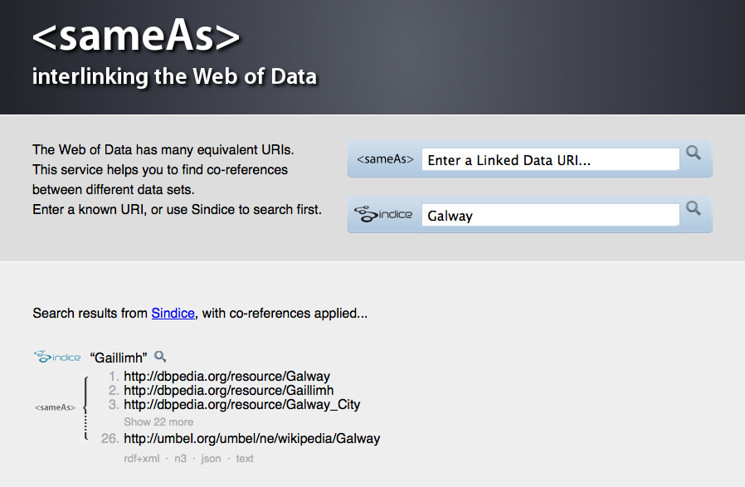
Technologies – sameas.org
Sameas.org is a service to find co-references on the Web of Data
http://sameas.org/html?q=Galway

Slide 66
Querying Linked Data

Slide 67
The following slides are based on:
SPARQL By Example: The Cheat Sheet
http://www.slideshare.net/LeeFeigenbaum/sparql-cheat-sheet
Lee Feigenbaum <lee@cambridgesemantics.com>
VP Technology & Standards, Cambridge Semantics
Co-chair, W3C SPARQL Working Group

Slide 68
Nuts & Bolts
URIs
Literals
Write full URIs:
<http://this.is.a/full/URI/written#out>
Abbreviate URIs with prefixes:
PREFIX foo: <http://this.is.a/URI/prefix#>
… foo:bar …
⇨ http://this.is.a/URI/prefix#bar
Shortcuts:
a ⇨ rdf:type
Plain literals:
“a plain literal”
Plain literal with language tag:
“bonjour”@fr
Typed literal:
“13”^^xsd:integer
Shortcuts:
true ⇨ “true”^^xsd:boolean
3 ⇨ “3”^^xsd:integer
4.2 ⇨ “4.2”^^xsd:decimal
Variables
Comments
Variables:
?var1, ?anotherVar, ?and_one_more
Comments:
# Comments start with a ‘#’ # continue to the end of the line
Triple Patterns
Match an exact RDF triple:
ex:myWidget ex:partNumber “XY24Z1” .
Match one variable:
?person foaf:name “Lee Feigenbaum” .
Match multiple variables:
conf:SemTech2009 ?property ?value .

Slide 69
Common Prefixes
prefix... | …stands for
rdf: | http://xmlns.com/foaf/0.1/
rdfs: | http://www.w3.org/2000/01/rdf-schema#
owl: | http://www.w3.org/2002/07/owl#
xsd: | http://www.w3.org/2001/XMLSchema#
dc: | http://purl.org/dc/elements/1.1/
foaf: | http://xmlns.com/foaf/0.1/
More common prefixes at http://prefix.cc

Slide 70
Anatomy of a Query
Declare prefix
shortcuts
(optional)
PREFIX foo: <…>
PREFIX bar: <…>
…
SELECT …
FROM <…>
FROM NAMED <…>
WHERE {
…
}
GROUP BY …
HAVING …
ORDER BY …
LIMIT …
OFFSET …
BINDINGS …
Query result
clause
Define the
dataset (optional)
Query pattern
Query modifiers
(optional)

Slide 71
4 Types of SPARQL Queries
SELECT queries
CONSTRUCT queries
Project out specific variables and expressions:
SELECT ?c ?cap (1000 * ?people AS ?pop)
Project out all variables:
SELECT *
Project out distinct combinations only:
SELECT DISTINCT ?country
Results in a table of values (in XML or JSON):
Construct RDF triples/graphs:
CONSTRUCT {
?country a ex:HolidayDestination ;
ex:arrive_at ?capital ;
ex:population ?population .
}
Results in RDF triples (in any RDF serialization):
ex:France a ex:HolidayDestination ;
ex:arrive_at ex:Paris ;
ex:population 635000000 .
ex:Canada a ex:HolidayDestination ;
ex:arrive_at ex:Ottawa ;
ex:population 329000000 .
?c | ?cap | ?pop
ex:France | ex:Paris | 63,500,000
ex:Canada | ex:Ottawa | 32,900,000
ex:Italy | ex:Rome | 58,900,000
ASK queries
DESCRIBE queries
Ask whether or not there are any matches:
ASK
Result is either “true” or “false” (in XML or JSON):
true, false
Describe the resources matched by the given variables:
DESCRIBE ?country
Result is RDF triples (in any RDF serialization) :
ex:France a geo:Country ;
ex:continent geo:Europe ;
ex:flag <http://…/flag-france.png> ;
…

Slide 72
Combining SPARQL Graph Patterns
Consider A and B as graph patterns.
A Basic Graph Pattern – one or more triple patterns
A . B
⇨ Conjunction. Join together the results of solving A and B by matching the values of any variables in common.
Optional Graph Patterns
A OPTIONAL { B }
⇨ Left join. Join together the results of solving A and B by matching the values of any variables in common, if possible. Keep all solutions from A whether or not there’s a matching solution in B

Slide 73
Combining SPARQL Graph Patterns
Consider A and B as graph patterns.
Either-or Graph Patterns
{ A } UNION { B }
⇨ Disjunction. Include both the results of solving A and the results of solving B.
“Subtracted” Graph Patterns (SPARQL 1.1)
A MINUS { B }
⇨ Negation. Solve A. Solve B. Include only those results from solving A that are not compatible with any of the results from B.

Slide 74
SPARQL Filters
SPARQL FILTERs eliminate solutions that do not cause an expression to evaluate to true.
Place FILTERs in a query inline within a basic graph pattern
A . B . FILTER ( …expr… )
Category | Functions / Operators | Examples
Logical | !, &&, ||, =, !=, <, <=, >, >= | ?hasPermit || ?age < 25
Math | +, -, *, / | ?decimal * 10 > ?minPercent
Existence (SPARQL 1.1) | EXISTS, NOT EXISTS | NOT EXISTS { ?p foaf:mbox ?email }
SPARQL tests | isURI, isBlank, isLiteral, bound | isURI(?person) || !bound(?person)
Accessors | str, lang, datatype | lang(?title) = “en”
Miscellaneous | sameTerm, langMatches, regex | regex(?ssn, “\\d{3}-\\d{2}-\\d{4}”)

Slide 75
RDF Datasets
A SPARQL queries a default graph (normally) and zero or more named graphs (when inside a GRAPH clause).
Default graph
(the merge of zero or more graphs)
PREFIX ex: <…>
SELECT …
FROM ex:g1
FROM ex:g4
FROM NAMED ex:g1
FROM NAMED ex:g2
FROM NAMED ex:g3
WHERE {
… A …
GRAPH ex:g3 {
… B …
}
GRAPH ?g {
… C …
}
}
ex:g1
ex:g4
Named graphs
ex:g3
ex:g1
OR
ex:g2
OR

Slide 76
SPARQL Over HTTP (the SPARQL Protocol)
http://host.domain.com/sparql/endpoint?<parameters>
where <parameters> can include:
query=<encoded query string>
e.g. SELECT+*%0DWHERE+{…
default-graph-uri=<encoded graph URI>
e.g. http%3A%2F%2Fexmaple.com%2Ffoo…
n.b. zero of more occurrences of default-graph-uri
named-graph-uri=<encoded graph URI>
e.g. http%3A%2F%2Fexmaple.com%2Fbar…
n.b. zero of more occurrences of named-graph-uri
HTTP GET or POST. Graphs given in the protocol override graphs given in the query.

Slide 77
Federated Query (SPARQL 1.1)
Local Graph Store
PREFIX ex: <…>
SELECT …
FROM ex:g1
WHERE {
… A …
SERVICE ex:s1 {
… B …
}
SERVICE ex:s2 {
… C …
}
}
ex:g1
SPARQL Endpoint ex:s1
Web
SPARQL Endpoint ex:s2

Slide 78
SPARQL 1.1 Update
SPARQL Update Language Statements
INSERT DATA { triples }
DELETE DATA {triples}
[ DELETE { template } ] [ INSERT { template } ] WHERE { pattern }
LOAD <uri> [ INTO GRAPH <uri> ]
CLEAR GRAPH <uri>
CREATAE GRAPH <uri>
DROP GRAPH <uri>
[ … ] denotes optional parts of SPARQL 1.1 Update syntax

Slide 79
Some Public SPARQL Endpoints
Name | URL | What’s there?
SPARQLer | http://sparql.org/sparql.html | General-purpose query endpoint for Web-accessible data
DBPedia | http://dbpedia.org/sparql | Extensive RDF data from Wikipedia
DBLP | http://www4.wiwiss.fu-berlin.de/dblp/snorql/ | Bibliographic data from computer science journals and conferences
LinkedMDB | http://data.linkedmdb.org/sparql | Films, actors, directors, writers, producers, etc.
World Factbook | http://www4.wiwiss.fu-berlin.de/factbook/snorql/ | Country statistics from the CIA World Factbook
bio2rdf | http://bio2rdf.org/sparql | Bioinformatics data from around 40 public databases

Slide 80
SPARQL Resources
The SPARQL Specification
http://www.w3.org/TR/rdf-sparql-query/
SPARQL implementations
http://esw.w3.org/topic/SparqlImplementations
SPARQL endpoints
http://esw.w3.org/topic/SparqlEndpoints
http://labs.mondeca.com/sparqlEndpointsStatus/
SPARQL Frequently Asked Questions
http://www.thefigtrees.net/lee/sw/sparql-faq
SPARQL Working Group
http://www.w3.org/2009/sparql/wiki/
Common SPARQL extensions
http://esw.w3.org/topic/SPARQL/Extensions

Slide 81
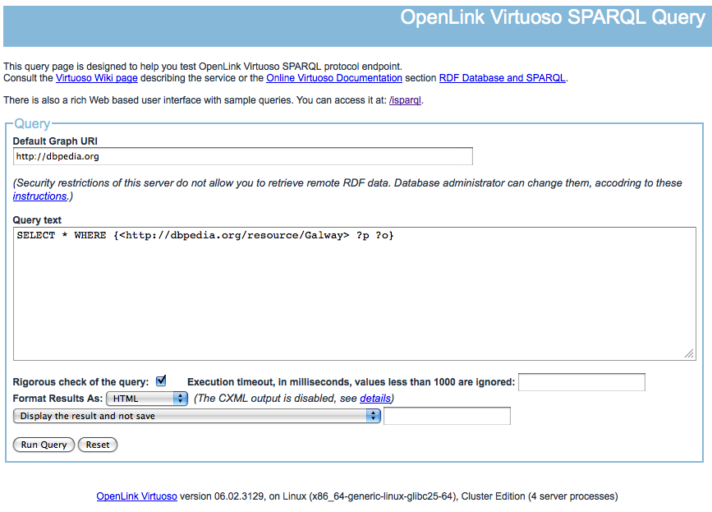
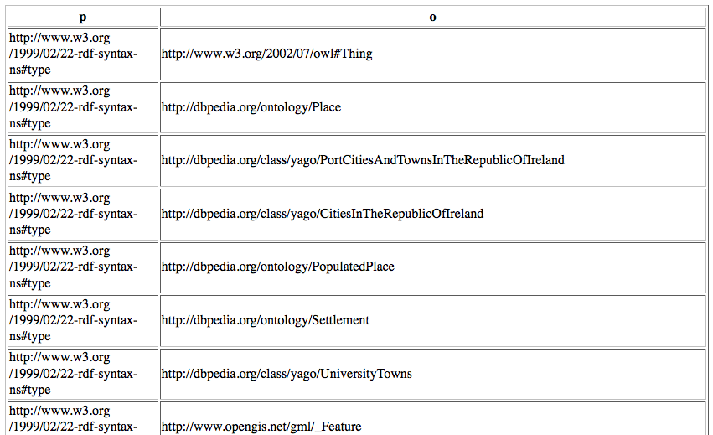
Hands-on: Querying DBpedia
http://dbpedia.org/sparql
SELECT * WHERE { <http://dbpedia.org/resource/Galway> ?p ?o .
}
81

Slide 82
Questions?

