Slide 1
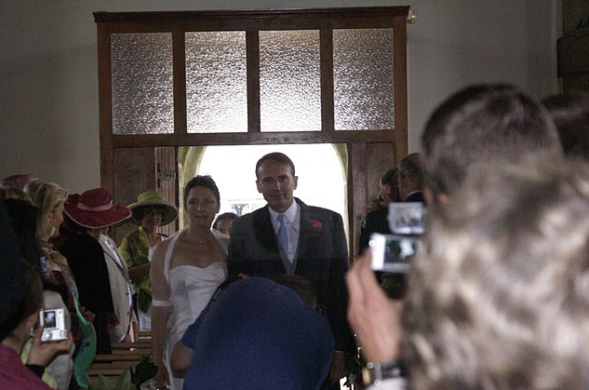
Mining social networks and their visual semantics from social photos
Michel Crampes
Michel Plantié
LGI2P - Ecole des Mines d’Ales

Slide 2
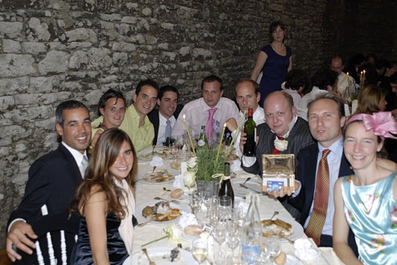
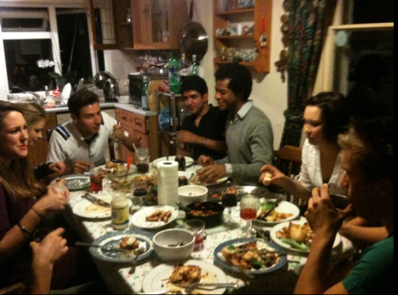
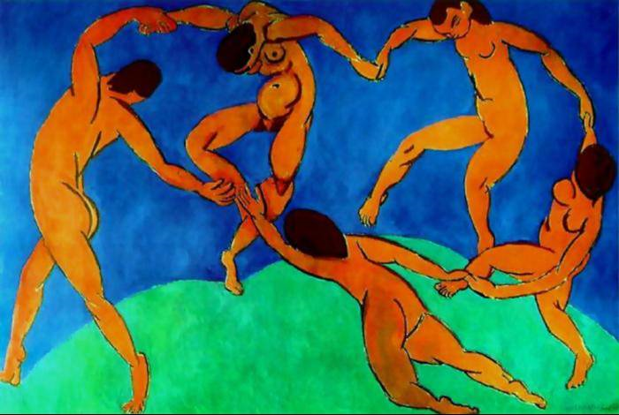
Social Photos
Events
family
friends
…
Proximity Social Networks

Slide 3
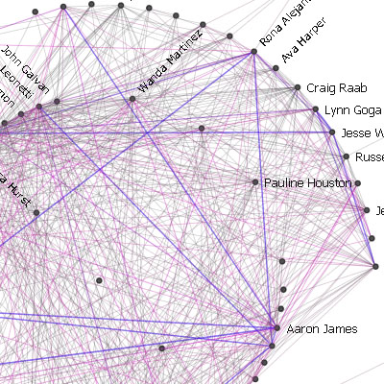
Social Networks:
State of the art
Explicit Networks (facebook, hyperlinks,…)
Computed Networks:
Sources: Document corpora, Web links, messages, …
Methods: cooccurrences (coauthorships, …), semantic distances.
Formalisms: graphs, hypergraphs, Galois lattices
Goals: observations (visualisations), analysis (centrality, …)

Slide 4
Social Networks :
our contribution
Explicit Networks (for test only)
Computed Networks :
Sources: social photos, …
Methods with semantics: cooccurrence , proximity, cohesion
Formalisms : graphs, hypergraphs, Galois lattices,
Goals: observations (visualisation), photos diffusion

Slide 5
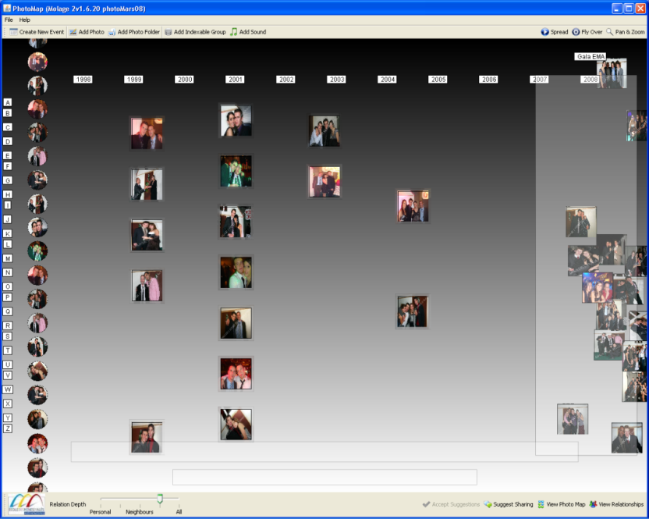
From photos to concepts
(Crampes et al. 2009)
Photos Organised as Galois lattices
Concept: a group of photos (extent) having the same groupe of people (intent)

Slide 6
Simple Force
Classic Cooccurrence
Frequency of appearence of a couple in the event
No expression of the couple link strength

Slide 7
Proximity
Based on: probability that a relation between two persons exists in mids of a group …
Express the non dilution of a couple in all the groups in which they are in
No expression of the couple link strength

Slide 8
Cohesion
Semantics: ’’Inseparability’’ level of a couple (expression of the link strength of a couple)
Dilution in groups not taken into account
Principle: Jaccard distance

Slide 9
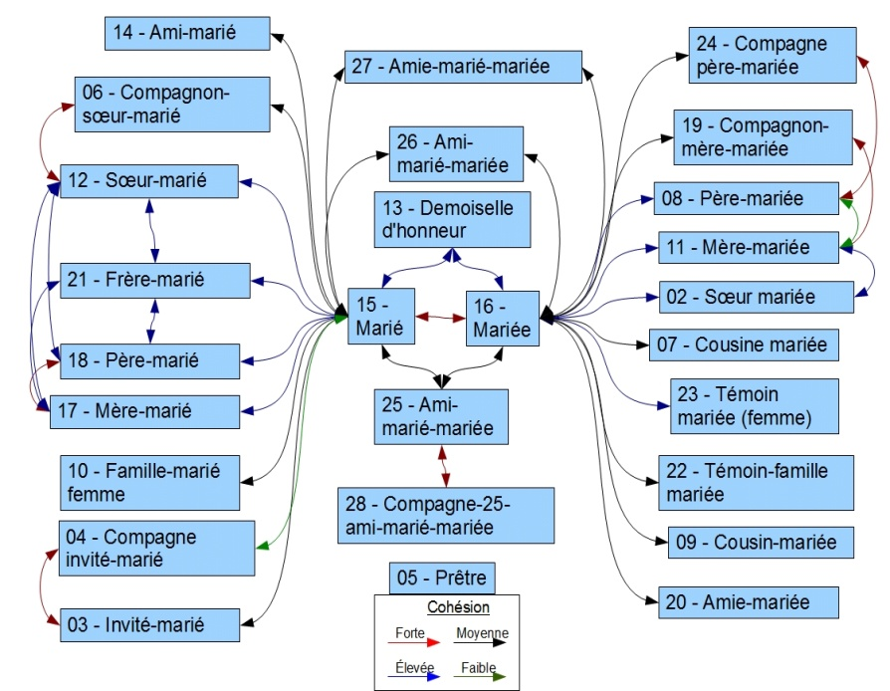
Socio-Event Analysis
Wedding
28 persons
127 photo-concepts
Civil situations = reference observed network

Slide 10
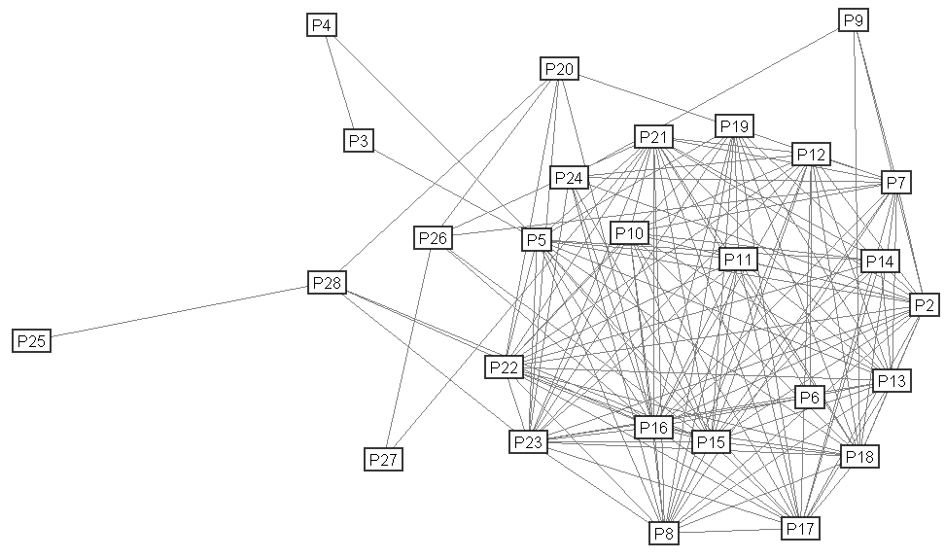
Rough extracted network
Number of links :
Simple Force: 146
Proximity: 138
Cohesion: 149
Example :
MDS projection of cohesion (Molage software)

Slide 11
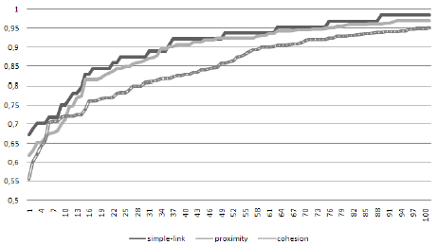
Graph Reduction
Suppress weakest links:
Threshold choice problem
Edge number versus selected threshold:
Cohesion is the most linear; simple force and proximity have a similar behavior
Selection: threshold that keeps 33 edges
(the same as the reference graph)

Slide 12
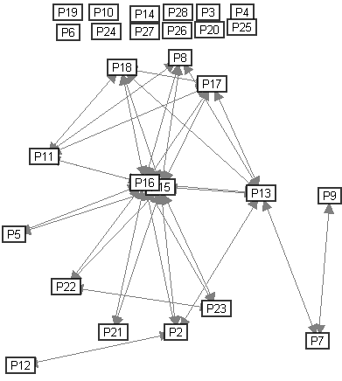
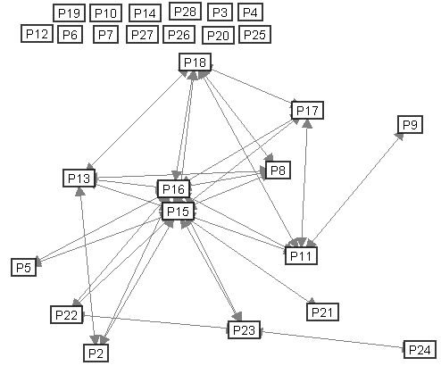
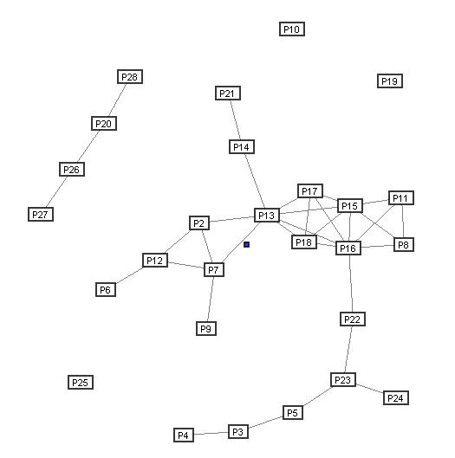
Reduced networks comparaison
Proximity
Simple Force
Simple Force and proximity:
similar,
A lot of singletons (invited persons),
Centered on bride and groom
Cohesion :
homogeneity
few singletons
Few couples visualisations
Semantic Analysis?

Slide 13
Analysis
Pearson test on node degrees:
Similarity for SF and Proximity.
Good overall corelation
Recall and Precision: Edges/ referent graph
Nota :
Recall= edge number of civil graph among the computed social graph versus le edge number of civil graph
Precision = edge number of civil graph among the computed social graph versus edge number of the computed social graph

Slide 14
Analysis : conclusions
Pearson test on node degrees :
Good overall correlation on characters centrality
Recall/ referent graph
Photos ignore ‘civil’ links (cohesion looks ‘the best’)
Precision/ referent graph
Photos produce new links (new encounters) than civil links. (cohesion is the most ‘creative’)
Paradox: all the three forces, very different, have a f-measure very close

Slide 15
From graphs to hypergraphs for photo distribution
Group computation (tribes) and photo distribution to each group
Questions: Which groups, which visualisation, which photos to whom?
Tribe = Hyperedge of force related hypergraph

Slide 16
From graphs to hypergraphs
Connexity graph methods
Based on a variable threshold
(Plantié & Crampes 2010):
Identifie all sub-graphs,
Compute their connexity value,
And keep those graphs with a connexity level higher than a given threshold
Drawbacks, shortcomings:
Groups are not dépending on nodes and non ‘subjectives’ (do not integrate the membership point of vue)
Symetry although the social relation is not symetic
Complexity : 2^{n}

Slide 17
From graphs to hypergraphs
Other method Disk centered method:
Compute sub-groups from each node with a thresholds
Example: sub-group P15-P16 viewed from P15 and from P16
Benefits:
Linear complexity
Subjectivity: a person belongs to groups as ‘perceived’ by others.
Non symetric
Drawbacks, shortcomings:
Needs to consider other semantic factors

Slide 18
Photos Distribution
Method:
Jackard Distance between intent of a photo group (concept) and computed tribes with 0.5 as threshold (majority of persons in the photo are in the tribe)
Persons
Jacccard Distance
photos / tribes
Photos (intent)
TRIBES
K
PERSONNES
H ^{t}
Drawback:
Any photo having few people is poorly distributed in the crowded tribes => lower the threshold to get more photos

Slide 19
Photo Distribution: Evaluation
Method:
C1 Criterion: persons get photos where there are in => 415 photos
C2 Criterion: persons get photos where there or their relatives are in (parents, children, brothers/sisters, close friends) => 901 photos
Strategy 1:
photos => persons in photos | C1 | C2
recall | 100% | 46%
precision | 100% | 100%
F-measure | 100% | 63,1%
Evaluation:
C1 perfect
C2 : not bad, recall should be enhanced
People expect more photos

Slide 20
Photo Distribution: Evaluation
Strategy 2 versus C2 criteria:
Jaccard distance | Simple force | Cohesion | proximity
recall | 57,05% | 50,28% | 55,49%
precision | 95,19% | 97,21% | 95,79%
F-measure | 71,34% | 66,28% | 70,27%
Strategy 3:
All photos => All persons | C1 | C2
recall | 100% | 100%
precision | 12,1% | 26,28%
F-measure | 21,6% | 41,6%
Evaluation: Strategy 2 is best
Future experiments:
Other distribution strategies based on a different distance
More detailled Evaluation method
HyperGraphs of centered tribes versus tribes (!!!)…

Slide 21
Conclusions and future works
Conclusions :
Building Social Networks from photos
Goals: personnalised distribution and other cognitive tasks based on computed social networks
Three different force types defined
Use of hypergraphs and Galois lattices formalisms
Experiment on wedding photos
Evaluation Method based on the civil graph as referent graph
Future works:
Explore more sophisticated personnalised distribution stratégies
Scalability: application to FaceBook !!!
Use of computed social networks for other personnalised usages (scientific documentation, …)

Slide 22
THANK YOU!
QUESTIONS?

Slide 23
Details
Precision is the probability that a (randomly selected) retrieved document is relevant.
Recall is the probability that a (randomly selected) relevant document is retrieved in a search.
F-score = harmonic mean

