Slide 1





Many Faces of Text Processing
Marko Grobelnik (marko.grobelnik@ijs.si)
Jozef Stefan Institute (http://www.ijs.si/)
Slovenia, Europe
Sogndal, May 27th 2011

Slide 2
Outline
Introduction
Demonstrations
  Data modeling with Support Vector Machines
  Classification into large taxonomies
  Contextual Search
  Text Enrichment
  Multilingual Search
  News Bias
  News Visualization
  Summarization
  Question Answering
  Deep Reasoning
Further references
  …events, books, videos

Slide 3
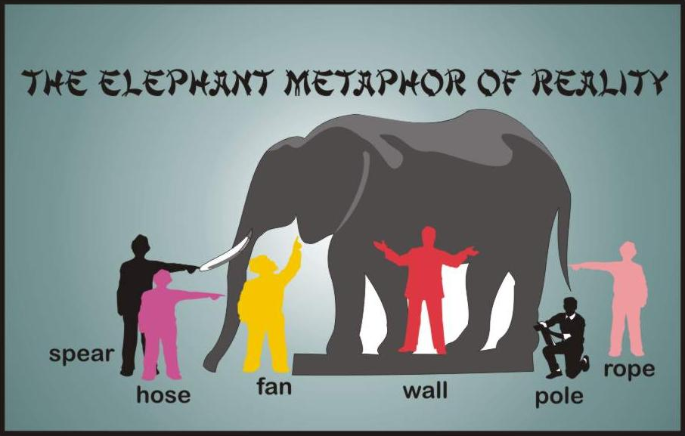
How technical research areas are approaching text and semantics?
Semantics
Social
Network
Analysis
graphs /
networks
Computational
Linguistics
Semantic Web
Text Mining
Information
Retrieval
Web2.0
Machine
Learning
language
community
interoperability
analytics
statistics
search

Slide 4
…some of the key issues from methodological side
Integration of three key scientific paradigms
  Top-down approaches
    (Semantic Web, KRR)
  Bottom-up approaches
    (Machine Learning, Data Mining)
  Collaborative approaches
    (Web2.0, Social Computing)
…integration of ideas opens possibilities to solve problems which were not easy solvable before

Slide 5
How do we represent text?

Slide 6
Levels of text representations
Language identification,
Copy detection
Character (character n-grams and sequences)
Words (stop-words, stemming, lemmatization)
Phrases (word n-grams, proximity features)
Part-of-speech tags
Taxonomies / thesauri
Vector-space model
Language models
Full-parsing
Cross-modality
Collaborative tagging / Web2.0
Templates / Frames
Ontologies / First order theories
Named entity extraction (names of people, places, organizations)
Lexical
Text categorization, Clustering, Search , Summarization, …
Spam filtering, Machine translation
Syntactic
Multilingual search, Associating text with images, …
Unifying semantics of data
Semantic
Reasoning,
Semantic search

Slide 7
Some demonstrations…
…from light-weight to heavy-weight

Slide 8
Classification into large taxonomies

Slide 9
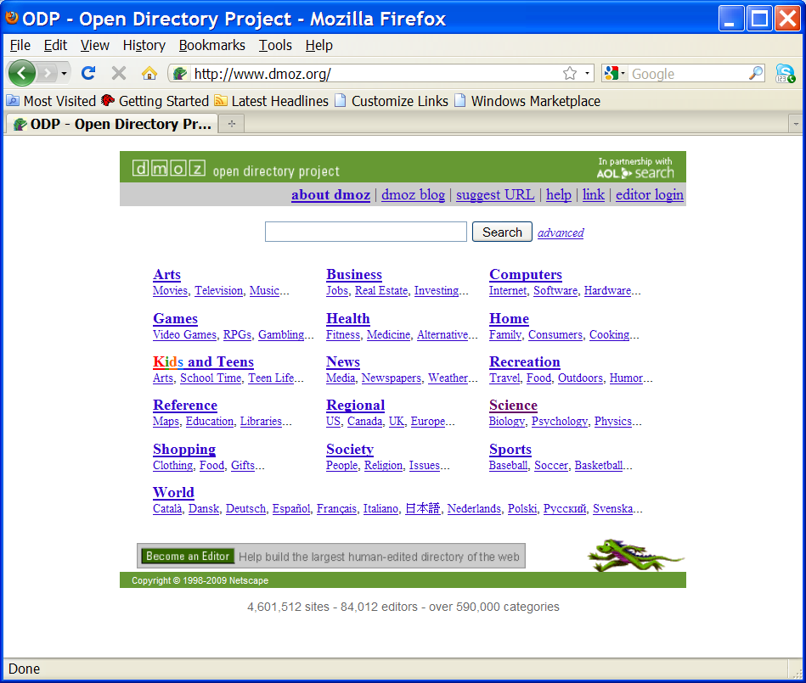
DMoz (Open Directory Project)

Slide 10
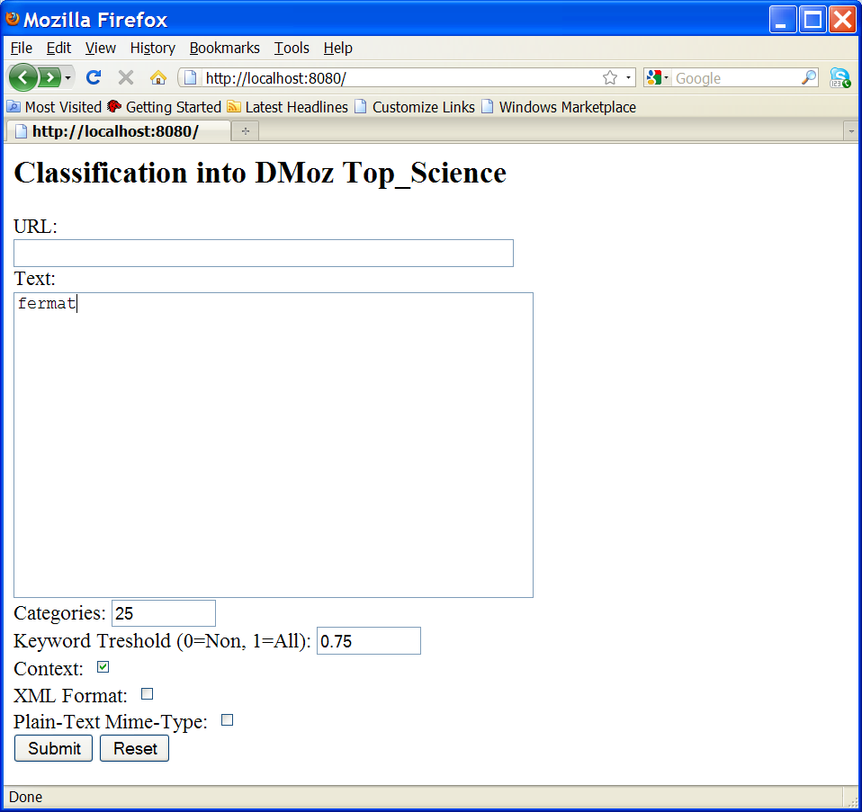
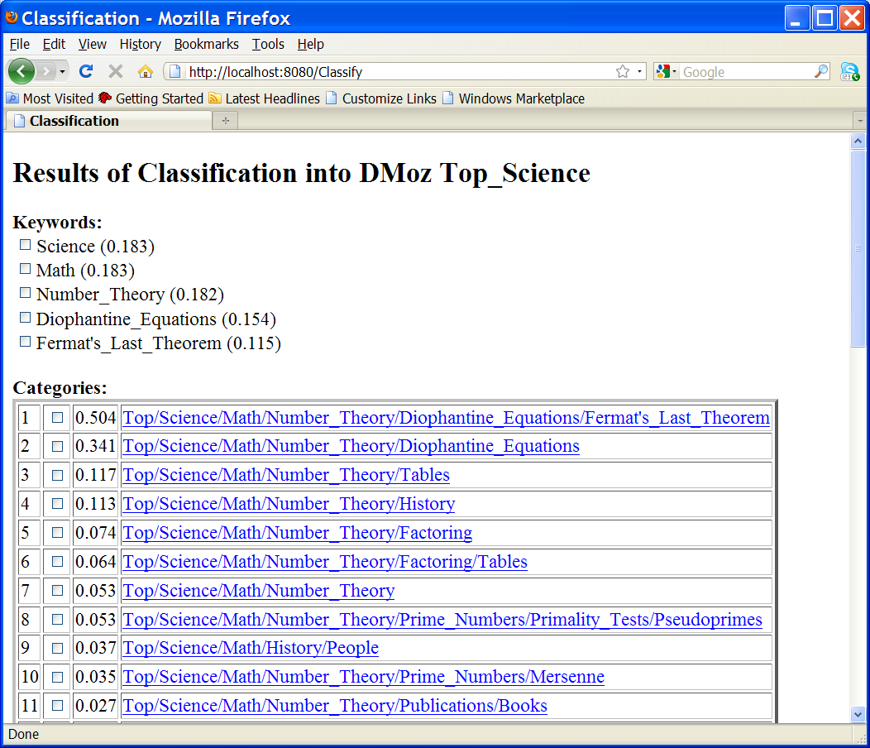
Classification of a query into DMoz

Slide 11
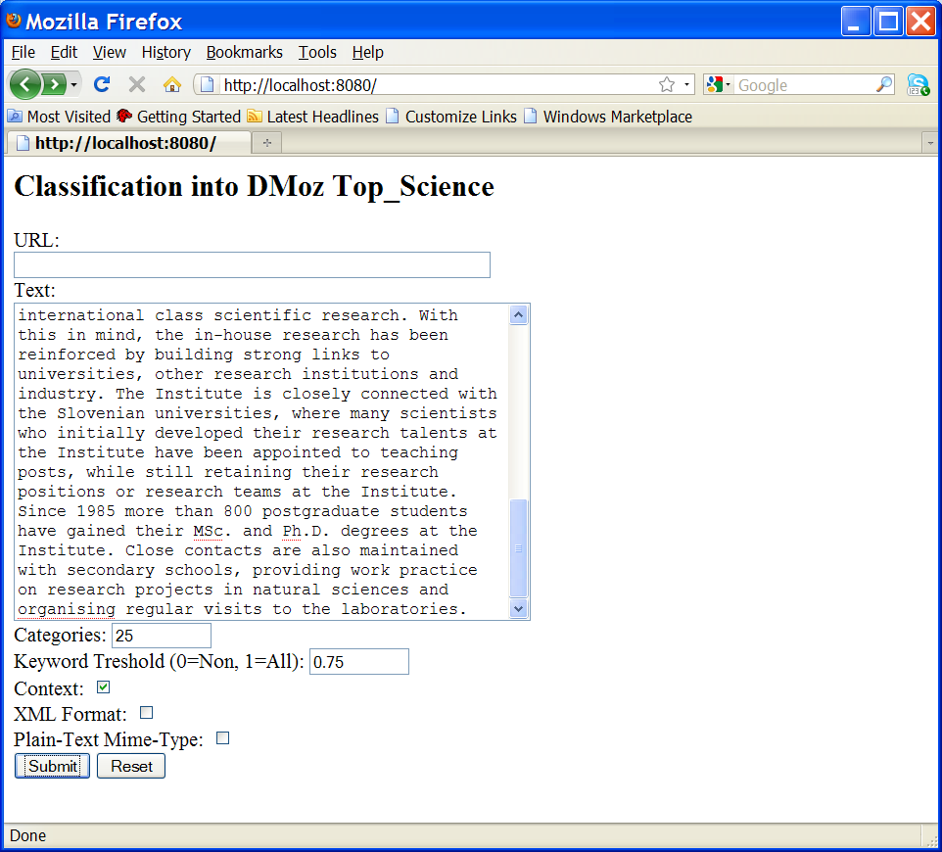
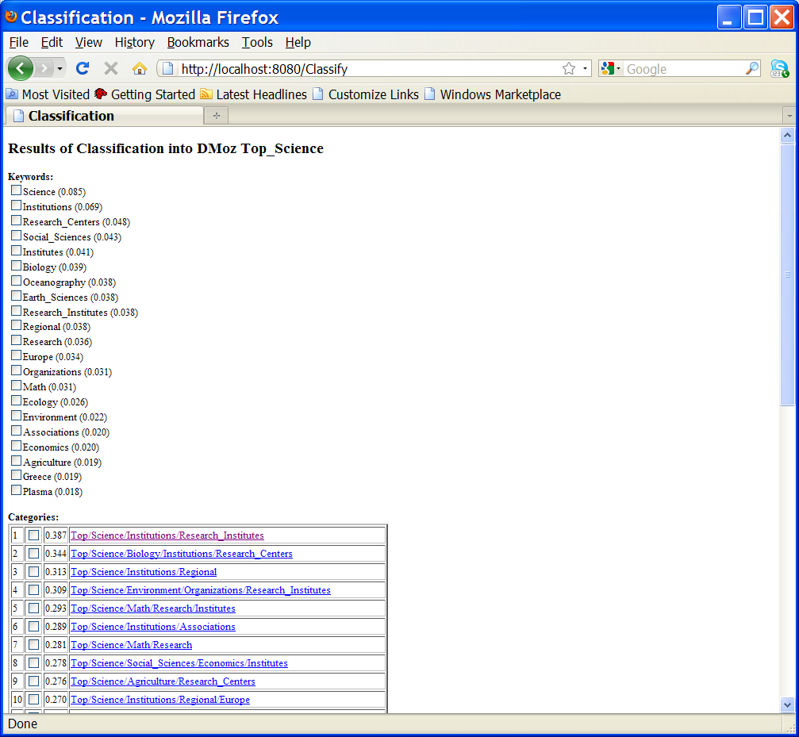
Classification of a document into DMoz

Slide 12
Visual & Contextual Search
(WWW2008)

Slide 13
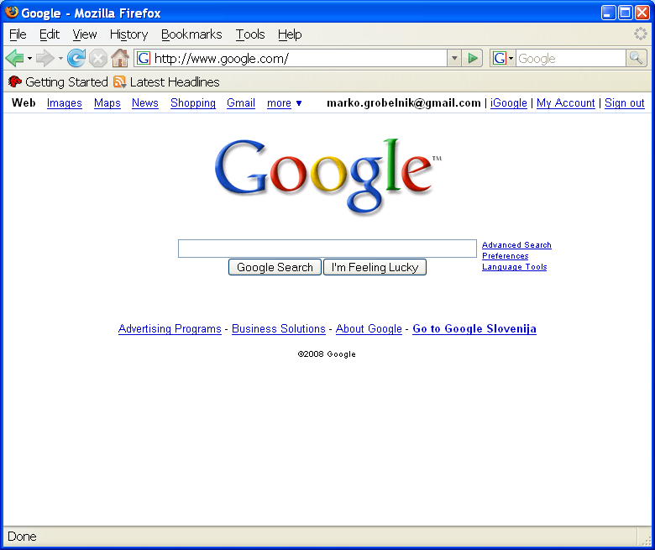
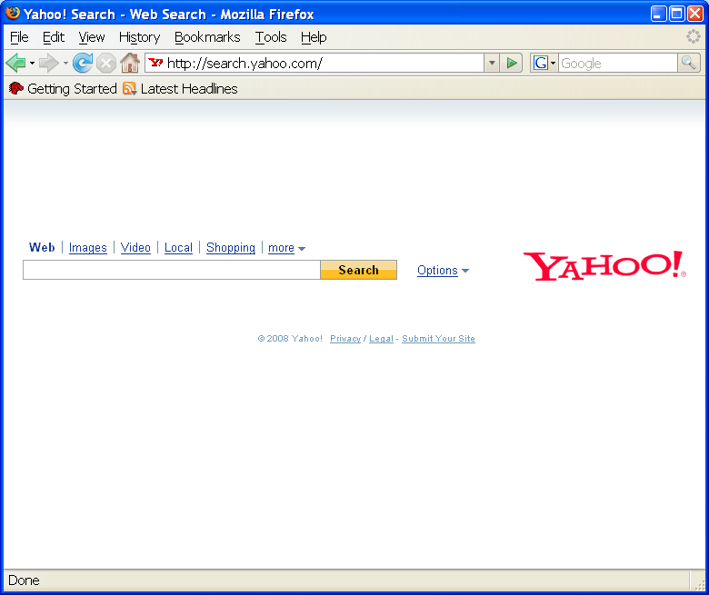
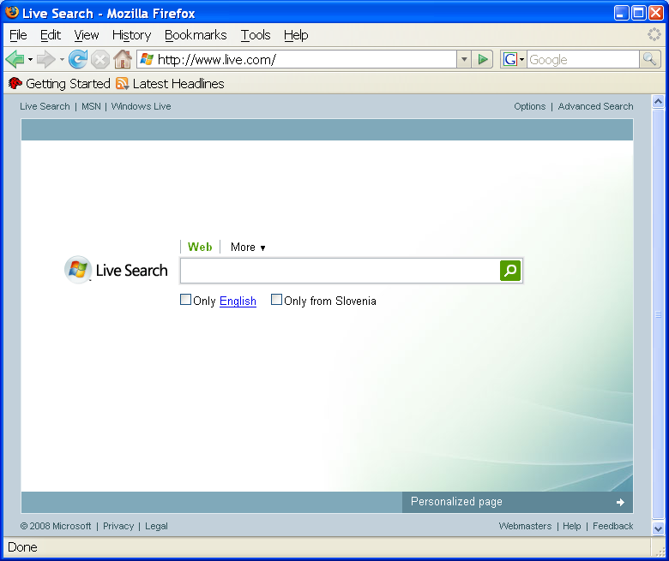
Contextualized search
What is the most common tasks where we manipulate text in everyday life?
  “Internet search”!
…but – how smart is search technology today?
  …not too smart!
  It is sophisticated, but not smart…

Slide 14
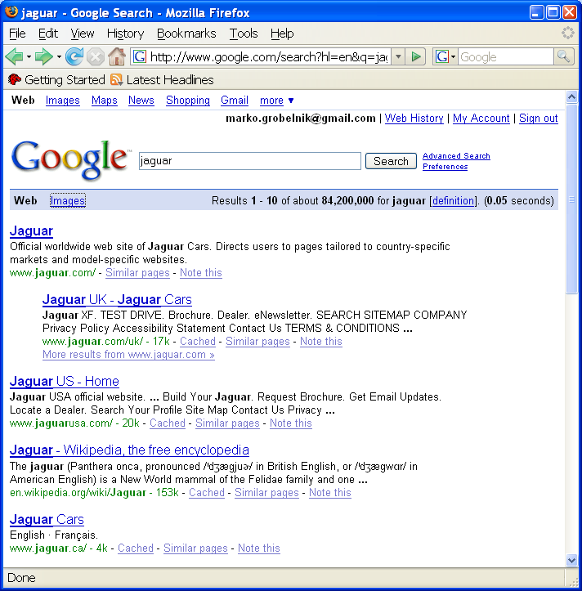
Example: searching for “Jaguar”
Query “jaguar” has many meanings…
…but the first page of search engines doesn’t provide us with many answers
…there are 84M more results

Slide 15
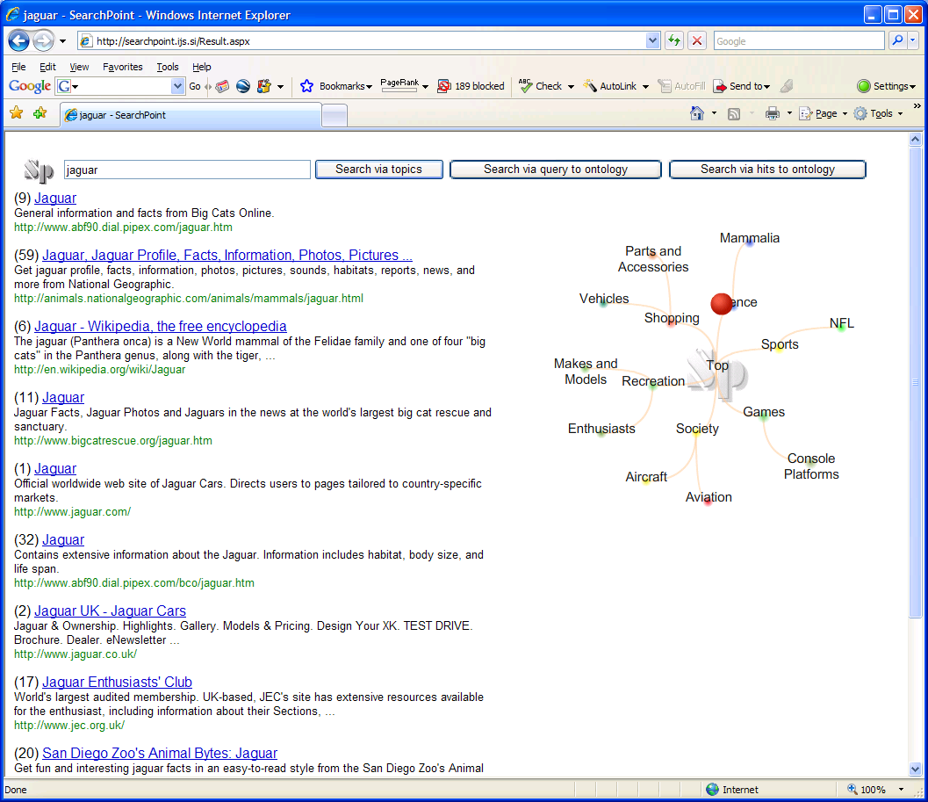
Context sensitive search with http://searchpoint.ijs.si
Query
Conceptual map
Search Point
Dynamic contextual
ranking based
on the search point

Slide 16
Text Enrichment
WWW2009-SemSearch

Slide 17
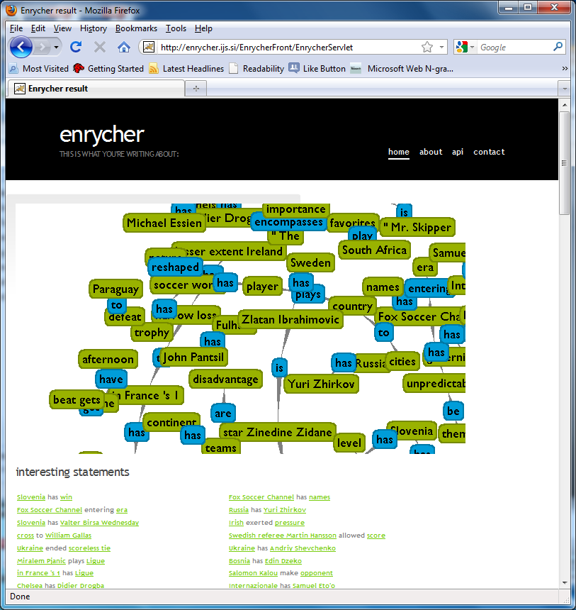
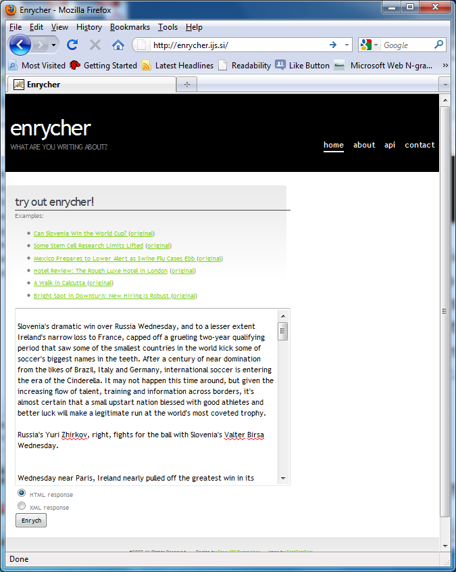
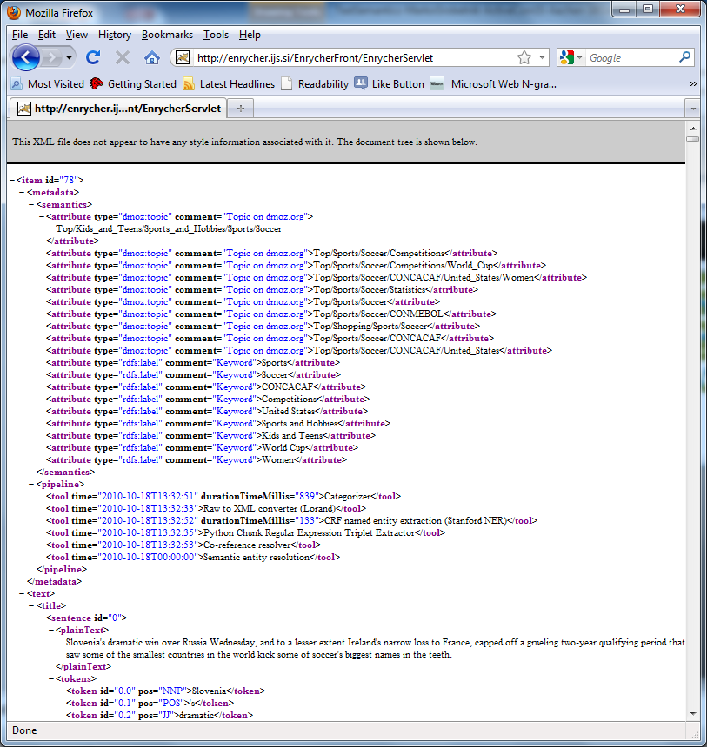
Text enrchment with http://Enrycher.ijs.si
HTML
Web service

Slide 18
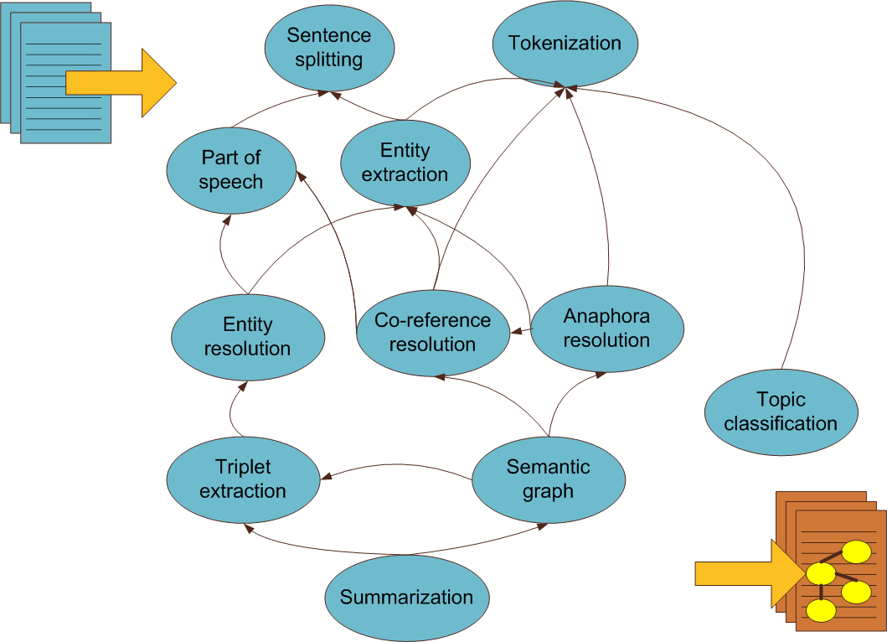
Text Enrichment
WWW2010-SemSearch

Slide 19

Multilingual search
http://www.smart-project.eu/

Slide 20
German
Slovenian
Slovak
English
Czech
French
Hungarian
Spanish
Canonical correlation analysis
Greek
Italian
Language Neutral
Document Representation
Danish
Finnish
Lithuanian
Swedish
transform
Dutch
New document
represented as text in
any of the above languages
New document
represented in
Language Neutral way
…enables cross-lingual retrieval, categorization, clustering, …

Slide 21
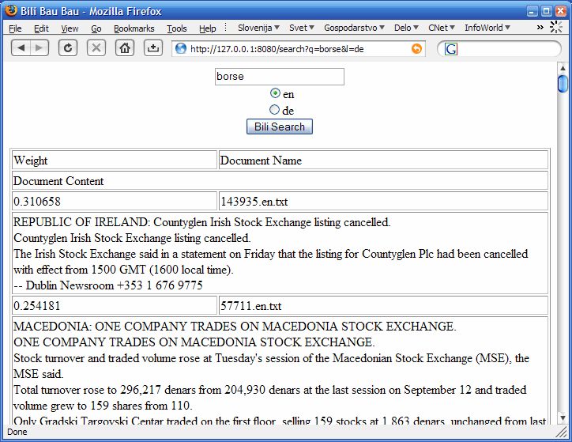
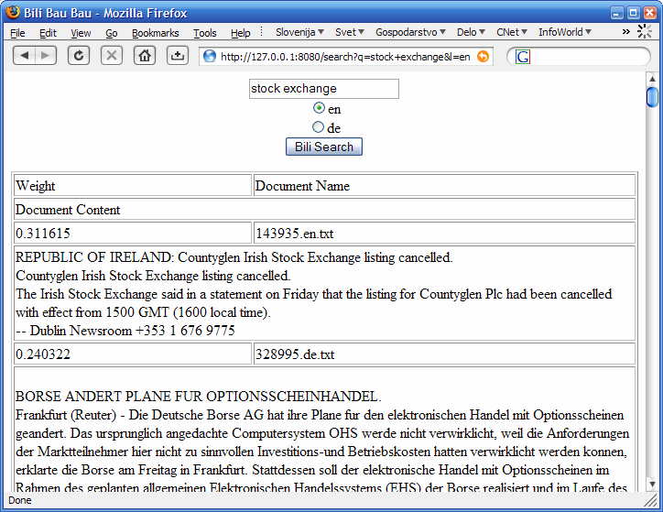
Example of cross-lingual information retrieval on Reuters news corpus (using KCCA)

Slide 22
News reporting bias
(Fortuna, Galleguillos, Cristianini 2008)

Slide 23
News Reporting Bias example

Slide 24
Experimental setup
Time period: March 31st 2005 – April 14th 2006
Size of collections:
Number of discovered matches:

Slide 25
Prediction of news source
The task: given a pair of news articles describing the same event, can we predict the news source for each?
In this experiment we focused on CNN and Al Jazeera.
SVM linear classifier was used for prediction
  Evaluation was done using 10-fold cross-validation
  Significance of results was tested against random matches

Slide 26
Detecting News Reporting Bias
The task:
  Given a news story, are we able to say from which news source it came?
We compared CNN and Aljazeera reports about the same events from the war in Iraq
  …300 aligned articles describing the same story from both sources
The same topics are expressed in both sources with the following keywords:
  CNN with:
    Insurgents, Troops, Baghdad, Iran, Militant, Police, Suicide, Terrorist, United, National, Hussein, Alleged, Israeli, Syria, Terrorism…
  Aljazeera with:
    Attacks, Claims, Rebels, Withdrawing, Report, Fighters, President, Resistance, Occupation, Injured, Army, Demanded, Hit, Muslim, …

Slide 27
News Visualization

Slide 28
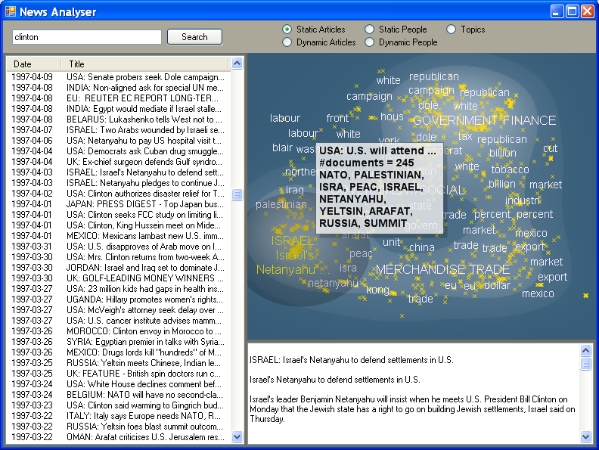
Topic landscape of the query “Clinton” from Reuters news 1996-1997
Query
Search
Results
Topic Map
Selected
group of news
Selected story

Slide 29
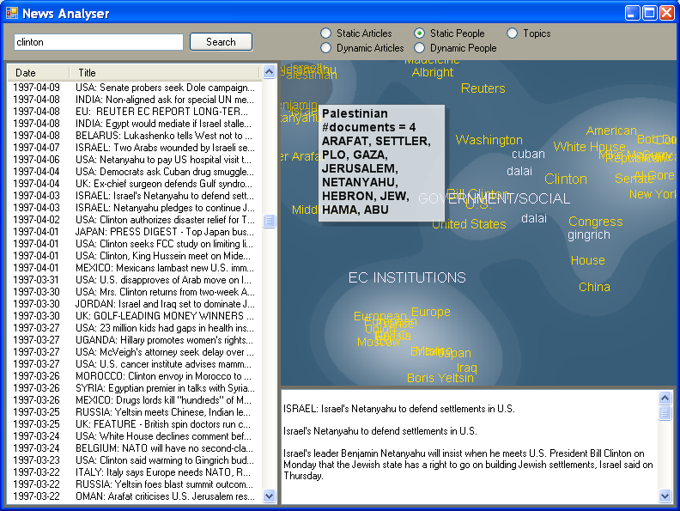
Visualization of social relationships between “Clinton” and other entities
Query
Named entities
in relation

Slide 30
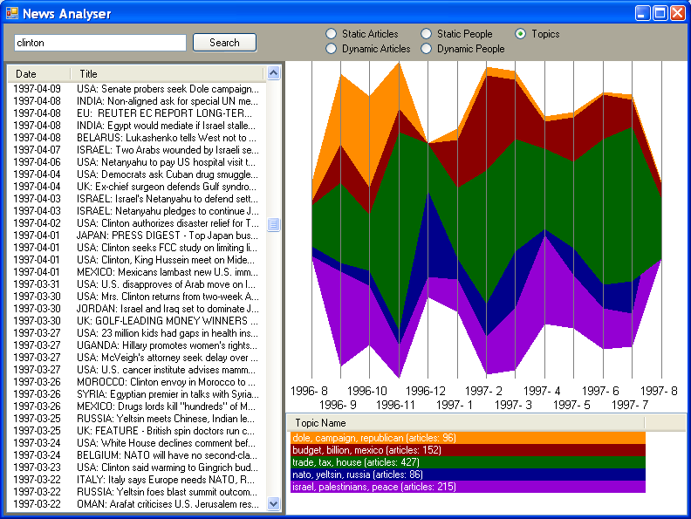
Topic Trends Tracking of the documents including “Clinton”
US Elections
US Budget
Query
Result set
NATO-Russia
Topic Trends
Visualization
Mid-East
conflict
Topics description

Slide 31
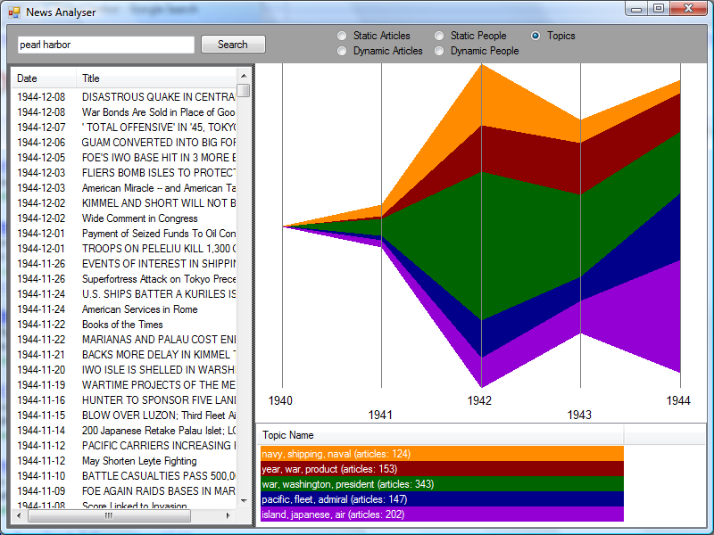
WW2 query “Pearl Harbor” into NYTimes archive
Dec 7th 1941

Slide 32
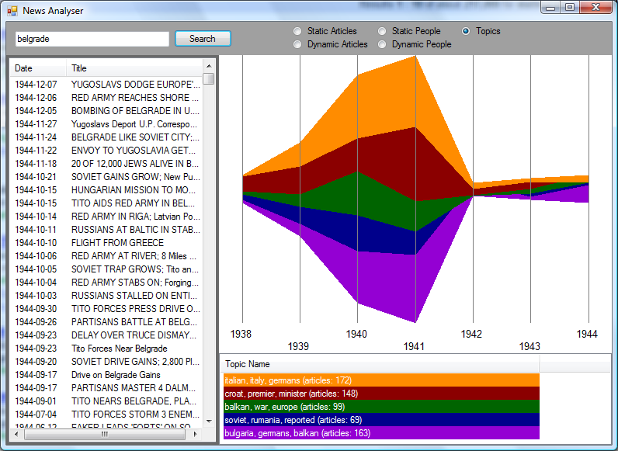
WW2 query “Belgrade” into NYTimes archive
Apr 6th 1941

Slide 33
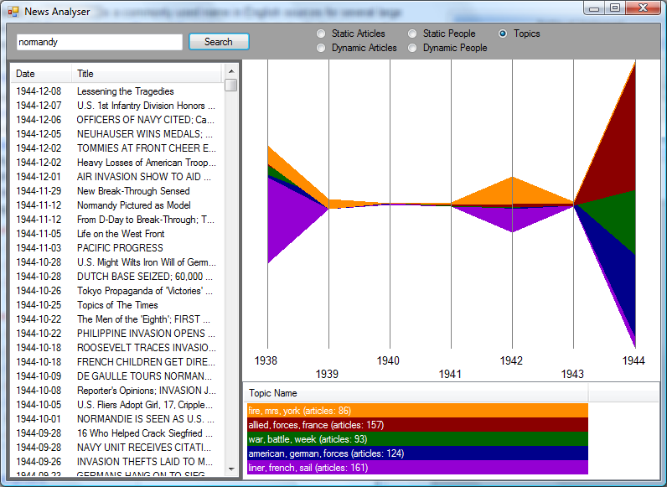
WW2 query “normandy” into NYTimes archive
June 1944

Slide 34
Knowledge based summarization
AAAI 2005

Slide 35
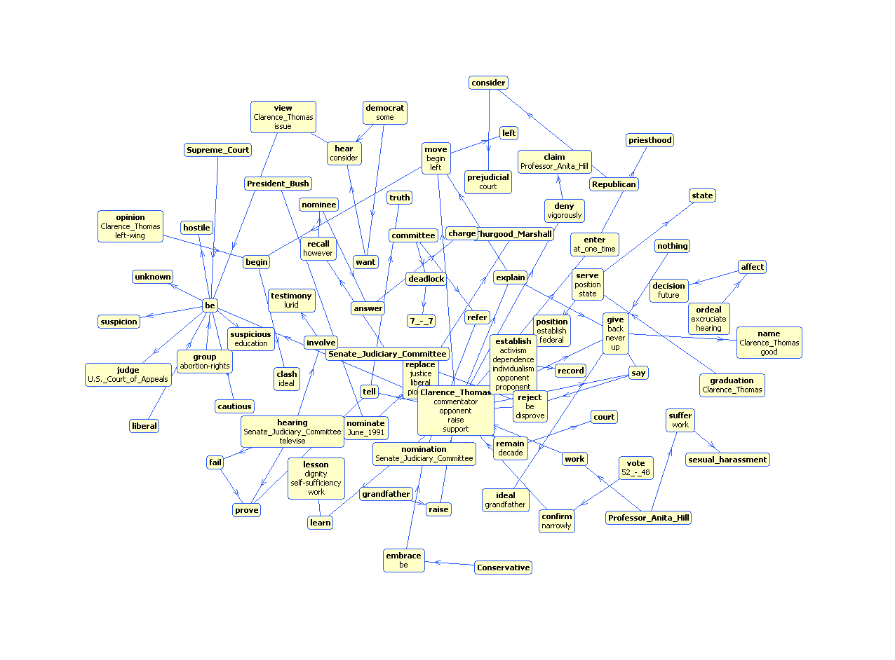
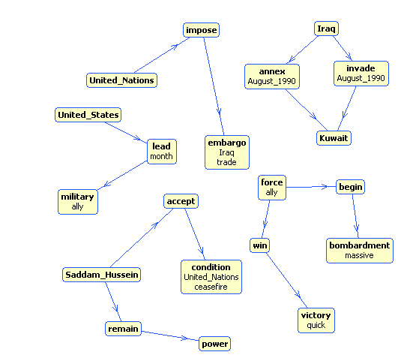
Cracks Appear in U.N. Trade Embargo Against Iraq.
Cracks appeared Tuesday in the U.N. trade embargo against Iraq as Saddam Hussein sought to circumvent the economic noose around his country. Japan, meanwhile, announced it would increase its aid to countries hardest hit by enforcing the sanctions. Hoping to defuse criticism that it is not doing its share to oppose Baghdad, Japan said up to $2 billion in aid may be sent to nations most affected by the U.N. embargo on Iraq. President Bush on Tuesday night promised a joint session of Congress and a nationwide radio and television audience that ``Saddam Hussein will fail'' to make his conquest of Kuwait permanent. ``America must stand up to aggression, and we will,'' said Bush, who added that the U.S. military may remain in the Saudi Arabian desert indefinitely. ``I cannot predict just how long it will take to convince Iraq to withdraw from Kuwait,'' Bush said. More than 150,000 U.S. troops have been sent to the Persian Gulf region to deter a possible Iraqi invasion of Saudi Arabia. Bush's aides said the president would follow his address to Congress with a televised message for the Iraqi people, declaring the world is united against their government's invasion of Kuwait. Saddam had offered Bush time on Iraqi TV. The Philippines and Namibia, the first of the developing nations to respond to an offer Monday by Saddam of free oil _ in exchange for sending their own tankers to get it _ said no to the Iraqi leader. Saddam's offer was seen as a none-too-subtle attempt to bypass the U.N. embargo, in effect since four days after Iraq's Aug. 2 invasion of Kuwait, by getting poor countries to dock their tankers in Iraq. But according to a State Department survey, Cuba and Romania have struck oil deals with Iraq and companies elsewhere are trying to continue trade with Baghdad, all in defiance of U.N. sanctions. Romania denies the allegation. The report, made available to The Associated Press, said some Eastern European countries also are trying to maintain their military sales to Iraq. A well-informed source in Tehran told The Associated Press that Iran has agreed to an Iraqi request to exchange food and medicine for up to 200,000 barrels of refined oil a day and cash payments. There was no official comment from Tehran or Baghdad on the reported food-for-oil deal. But the source, who requested anonymity, said the deal was struck during Iraqi Foreign Minister Tariq Aziz's visit Sunday to Tehran, the first by a senior Iraqi official since the 1980-88 gulf war. After the visit, the two countries announced they would resume diplomatic relations. Well-informed oil industry sources in the region, contacted by The AP, said that although Iran is a major oil exporter itself, it currently has to import about 150,000 barrels of refined oil a day for domestic use because of damages to refineries in the gulf war. Along similar lines, ABC News reported that following Aziz's visit, Iraq is apparently prepared to give Iran all the oil it wants to make up for the damage Iraq inflicted on Iran during their conflict. Secretary of State James A. Baker III, meanwhile, met in Moscow with Soviet Foreign Minister Eduard Shevardnadze, two days after the U.S.-Soviet summit that produced a joint demand that Iraq withdraw from Kuwait. During the summit, Bush encouraged Mikhail Gorbachev to withdraw 190 Soviet military specialists from Iraq, where they remain to fulfill contracts. Shevardnadze told the Soviet parliament Tuesday the specialists had not reneged on those contracts for fear it would jeopardize the 5,800 Soviet citizens in Iraq. In his speech, Bush said his heart went out to the families of the hundreds of Americans held hostage by Iraq, but he declared, ``Our policy cannot change, and it will not change. America and the world will not be blackmailed.'' The president added: ``Vital issues of principle are at stake. Saddam Hussein is literally trying to wipe a country off the face of the Earth.'' In other developments: _A U.S. diplomat in Baghdad said Tuesday up to 800 Americans and Britons will fly out of Iraqi-occupied Kuwait this week, most of them women and children leaving their husbands behind. Saddam has said he is keeping foreign men as human shields against attack. On Monday, a planeload of 164 Westerners arrived in Baltimore from Iraq. Evacuees spoke of food shortages in Kuwait, nighttime gunfire and Iraqi roundups of young people suspected of involvement in the resistance. ``There is no law and order,'' said Thuraya, 19, who would not give her last name. ``A soldier can rape a father's daughter in front of him and he can't do anything about it.'' _The State Department said Iraq had told U.S. officials that American males residing in Iraq and Kuwait who were born in Arab countries will be allowed to leave. Iraq generally has not let American males leave. It was not known how many men the Iraqi move could affect. _A Pentagon spokesman said ``some increase in military activity'' had been detected inside Iraq near its borders with Turkey and Syria. He said there was little indication hostilities are imminent. Defense Secretary Dick Cheney said the cost of the U.S. military buildup in the Middle East was rising above the $1 billion-a-month estimate generally used by government officials. He said the total cost _ if no shooting war breaks out _ could total $15 billion in the next fiscal year beginning Oct. 1. Cheney promised disgruntled lawmakers ``a significant increase'' in help from Arab nations and other U.S. allies for Operation Desert Shield. Japan, which has been accused of responding too slowly to the crisis in the gulf, said Tuesday it may give $2 billion to Egypt, Jordan and Turkey, hit hardest by the U.N. prohibition on trade with Iraq. ``The pressure from abroad is getting so strong,'' said Hiroyasu Horio, an official with the Ministry of International Trade and Industry. Local news reports said the aid would be extended through the World Bank and International Monetary Fund, and $600 million would be sent as early as mid-September. On Friday, Treasury Secretary Nicholas Brady visited Tokyo on a world tour seeking $10.5 billion to help Egypt, Jordan and Turkey. Japan has already promised a $1 billion aid package for multinational peacekeeping forces in Saudi Arabia, including food, water, vehicles and prefabricated housing for non-military uses. But critics in the United States have said Japan should do more because its economy depends heavily on oil from the Middle East. Japan imports 99 percent of its oil. Japan's constitution bans the use of force in settling international disputes and Japanese law restricts the military to Japanese territory, except for ceremonial occasions. On Monday, Saddam offered developing nations free oil if they would send their tankers to pick it up. The first two countries to respond Tuesday _ the Philippines and Namibia _ said no. Manila said it had already fulfilled its oil requirements, and Namibia said it would not ``sell its sovereignty'' for Iraqi oil. Venezuelan President Carlos Andres Perez dismissed Saddam's offer of free oil as a ``propaganda ploy.'' Venezuela, an OPEC member, has led a drive among oil-producing nations to boost production to make up for the shortfall caused by the loss of Iraqi and Kuwaiti oil from the world market. Their oil makes up 20 percent of the world's oil reserves. Only Saudi Arabia has higher reserves. But according to the State Department, Cuba, which faces an oil deficit because of reduced Soviet deliveries, has received a shipment of Iraqi petroleum since U.N. sanctions were imposed five weeks ago. And Romania, it said, expects to receive oil indirectly from Iraq. Romania's ambassador to the United States, Virgil Constantinescu, denied that claim Tuesday, calling it ``absolutely false and without foundation.''.
Original document
Summarization via semantic graphs
Automatically generated
document summary
Cracks appeared in the U.N. trade embargo against Iraq. The State Department reports that Cuba and Romania have struck oil deals with Iraq as others attempt to trade with Baghdad in defiance of the sanctions. Iran has agreed to exchange food and medicine for Iraqi oil. Saddam has offered developing nations free oil if they send their tankers to pick it up. Thus far, none has accepted. Japan, accused of responding too slowly to the Gulf crisis, has promised $2 billion in aid to countries hit hardest by the Iraqi trade embargo. President Bush has promised that Saddam's aggression will not succeed.
Linguistic processing and Creation of semantic graph
Sentence extraction rule
Select a sub-graph that would characterize extracted summaries
Learn the sub-graph selection model

Slide 36
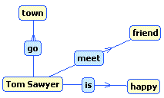
Detailed Summarization Procedure
Linguistic analysis of the text
- Deep parsing of sentences
Refinement of the text parse
- Named-entity consolidation
Determine that ’George Bush’ = ‘Bush’
= ‘U.S. president’
- Anaphora resolution
Link pronouns with name-entities
Extract Subject–Predicate–Object triples
Tom Sawyer went to town. He met a friend. Tom was happy. …
Tom Sawyer went to town. He [Tom Sawyer] met a friend. Tom [Tom Sawyer] was happy. …
Tom ← go → town
Tom ← meet → friend
Tom ← is → happy
Compose a graph from triples
Describe each triple with a set of features for learning
Learn a model to classify triples into the summary
Generate a summary graph
Use summary graph to generate textual document summary

Slide 37
Example of automatic summary
Cracks Appear in U.N. Trade Embargo Against Iraq.
Cracks appeared Tuesday in the U.N. trade embargo against Iraq as Saddam Hussein sought to circumvent the economic noose around his country. Japan, meanwhile, announced it would increase its aid to countries hardest hit by enforcing the sanctions. Hoping to defuse criticism that it is not doing its share to oppose Baghdad, Japan said up to $2 billion in aid may be sent to nations most affected by the U.N. embargo on Iraq. President Bush on Tuesday night promised a joint session of Congress and a nationwide radio and television audience that ``Saddam Hussein will fail'' to make his conquest of Kuwait permanent. ``America must stand up to aggression, and we will,'' said Bush, who added that the U.S. military may remain in the Saudi Arabian desert indefinitely. ``I cannot predict just how long it will take to convince Iraq to withdraw from Kuwait,'' Bush said. More than 150,000 U.S. troops have been sent to the Persian Gulf region to deter a possible Iraqi invasion of Saudi Arabia. Bush's aides said the president would follow his address to Congress with a televised message for the Iraqi people, declaring the world is united against their government's invasion of Kuwait. Saddam had offered Bush time on Iraqi TV. The Philippines and Namibia, the first of the developing nations to respond to an offer Monday by Saddam of free oil _ in exchange for sending their own tankers to get it _ said no to the Iraqi leader. Saddam's offer was seen as a none-too-subtle attempt to bypass the U.N. embargo, in effect since four days after Iraq's Aug. 2 invasion of Kuwait, by getting poor countries to dock their tankers in Iraq. But according to a State Department survey, Cuba and Romania have struck oil deals with Iraq and companies elsewhere are trying to continue trade with Baghdad, all in defiance of U.N. sanctions. Romania denies the allegation. The report, made available to The Associated Press, said some Eastern European countries also are trying to maintain their military sales to Iraq. A well-informed source in Tehran told The Associated Press that Iran has agreed to an Iraqi request to exchange food and medicine for up to 200,000 barrels of refined oil a day and cash payments. There was no official comment from Tehran or Baghdad on the reported food-for-oil deal. But the source, who requested anonymity, said the deal was struck during Iraqi Foreign Minister Tariq Aziz's visit Sunday to Tehran, the first by a senior Iraqi official since the 1980-88 gulf war. After the visit, the two countries announced they would resume diplomatic relations. Well-informed oil industry sources in the region, contacted by The AP, said that although Iran is a major oil exporter itself, it currently has to import about 150,000 barrels of refined oil a day for domestic use because of damages to refineries in the gulf war. Along similar lines, ABC News reported that following Aziz's visit, Iraq is apparently prepared to give Iran all the oil it wants to make up for the damage Iraq inflicted on Iran during their conflict. Secretary of State James A. Baker III, meanwhile, met in Moscow with Soviet Foreign Minister Eduard Shevardnadze, two days after the U.S.-Soviet summit that produced a joint demand that Iraq withdraw from Kuwait. During the summit, Bush encouraged Mikhail Gorbachev to withdraw 190 Soviet military specialists from Iraq, where they remain to fulfill contracts. Shevardnadze told the Soviet parliament Tuesday the specialists had not reneged on those contracts for fear it would jeopardize the 5,800 Soviet citizens in Iraq. In his speech, Bush said his heart went out to the families of the hundreds of Americans held hostage by Iraq, but he declared, ``Our policy cannot change, and it will not change. America and the world will not be blackmailed.'' The president added: ``Vital issues of principle are at stake. Saddam Hussein is literally trying to wipe a country off the face of the Earth.'' In other developments: _A U.S. diplomat in Baghdad said Tuesday up to 800 Americans and Britons will fly out of Iraqi-occupied Kuwait this week, most of them women and children leaving their husbands behind. Saddam has said he is keeping foreign men as human shields against attack. On Monday, a planeload of 164 Westerners arrived in Baltimore from Iraq. Evacuees spoke of food shortages in Kuwait, nighttime gunfire and Iraqi roundups of young people suspected of involvement in the resistance. ``There is no law and order,'' said Thuraya, 19, who would not give her last name. ``A soldier can rape a father's daughter in front of him and he can't do anything about it.'' _The State Department said Iraq had told U.S. officials that American males residing in Iraq and Kuwait who were born in Arab countries will be allowed to leave. Iraq generally has not let American males leave. It was not known how many men the Iraqi move could affect. _A Pentagon spokesman said ``some increase in military activity'' had been detected inside Iraq near its borders with Turkey and Syria. He said there was little indication hostilities are imminent. Defense Secretary Dick Cheney said the cost of the U.S. military buildup in the Middle East was rising above the $1 billion-a-month estimate generally used by government officials. He said the total cost _ if no shooting war breaks out _ could total $15 billion in the next fiscal year beginning Oct. 1. Cheney promised disgruntled lawmakers ``a significant increase'' in help from Arab nations and other U.S. allies for Operation Desert Shield. Japan, which has been accused of responding too slowly to the crisis in the gulf, said Tuesday it may give $2 billion to Egypt, Jordan and Turkey, hit hardest by the U.N. prohibition on trade with Iraq. ``The pressure from abroad is getting so strong,'' said Hiroyasu Horio, an official with the Ministry of International Trade and Industry. Local news reports said the aid would be extended through the World Bank and International Monetary Fund, and $600 million would be sent as early as mid-September. On Friday, Treasury Secretary Nicholas Brady visited Tokyo on a world tour seeking $10.5 billion to help Egypt, Jordan and Turkey. Japan has already promised a $1 billion aid package for multinational peacekeeping forces in Saudi Arabia, including food, water, vehicles and prefabricated housing for non-military uses. But critics in the United States have said Japan should do more because its economy depends heavily on oil from the Middle East. Japan imports 99 percent of its oil. Japan's constitution bans the use of force in settling international disputes and Japanese law restricts the military to Japanese territory, except for ceremonial occasions. On Monday, Saddam offered developing nations free oil if they would send their tankers to pick it up. The first two countries to respond Tuesday _ the Philippines and Namibia _ said no. Manila said it had already fulfilled its oil requirements, and Namibia said it would not ``sell its sovereignty'' for Iraqi oil. Venezuelan President Carlos Andres Perez dismissed Saddam's offer of free oil as a ``propaganda ploy.'' Venezuela, an OPEC member, has led a drive among oil-producing nations to boost production to make up for the shortfall caused by the loss of Iraqi and Kuwaiti oil from the world market. Their oil makes up 20 percent of the world's oil reserves. Only Saudi Arabia has higher reserves. But according to the State Department, Cuba, which faces an oil deficit because of reduced Soviet deliveries, has received a shipment of Iraqi petroleum since U.N. sanctions were imposed five weeks ago. And Romania, it said, expects to receive oil indirectly from Iraq. Romania's ambassador to the United States, Virgil Constantinescu, denied that claim Tuesday, calling it ``absolutely false and without foundation.''.
Human extracted summary
Eight years after a volcano scare incited fear, anger and economic gloom in Sierra resorts, residents are nonchalant about renewed underground lava movement that is triggering thousands of tiny earthquakes.
The resort town's 4,700 permanent residents live in Long Valley, a 19-mile-long, 9-mile-wide volcanic crater known as a caldera.
The Earth's crust is being stretched apart in the region, allowing molten rock to fill half-mile-wide chambers under the caldera.
The valley was created 730,000 years ago by one of Earth's most powerful eruptions, a blast that spewed 600 times more material than the May 1980 eruption of Mount St. Helens in Washington state.
Despite the current activity, the probability of a major earthquake or a volcanic eruption in the area is “less than 1 percent each year,” said David Hill, the U.S.
Geological Survey geophysicist in charge of research at Long Valley. Mono County Sheriff Martin Strelneck called such estimates “a scientific guessing game,” and said area residents rarely discuss the latest swarm of earthquakes, which started in May 1989.
As a result, the Geological Survey issued a “notice of potential volcanic hazard” for Long Valley in May 1982.
That warning, coupled with jarring earthquakes, damaged tourism and aggravated a recession in the once-booming real estate market.

Slide 38
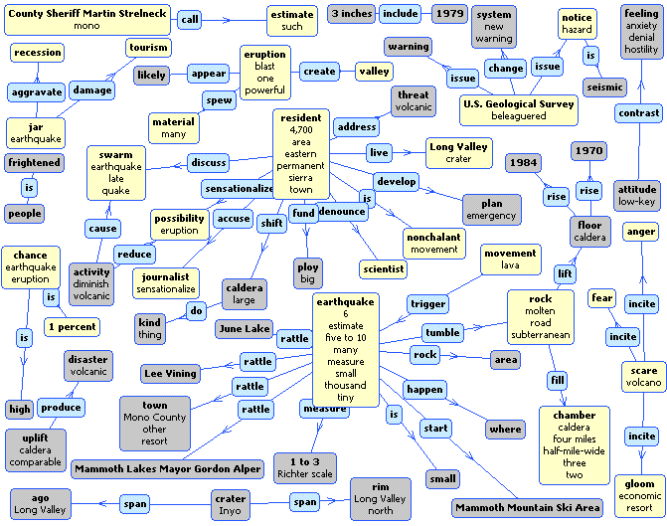
Full document semantic graph

Slide 39
Full document semantic graph

Slide 40
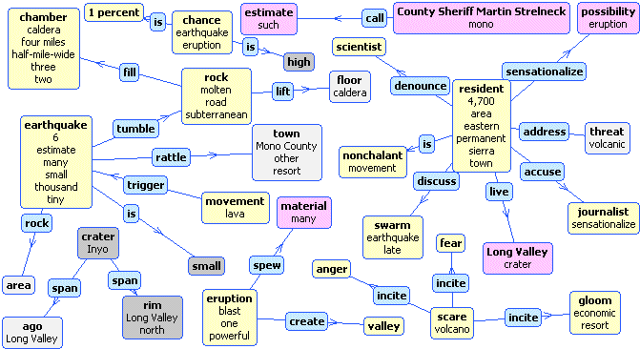
Automatically generated summary graph

Slide 41
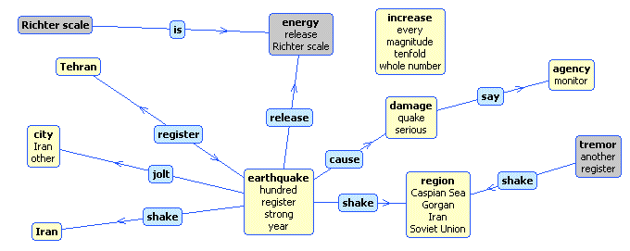
More examples

Slide 42
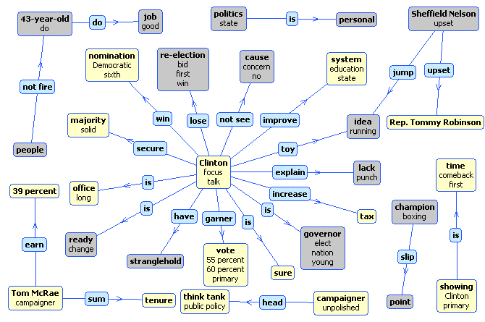

Slide 43
Question Answering
http://AnswerArt.net

Slide 44
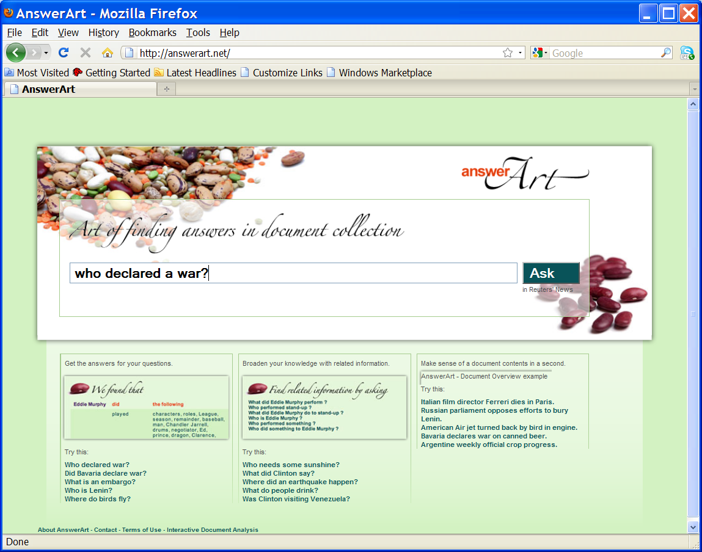
Asking a question in natural language

Slide 45
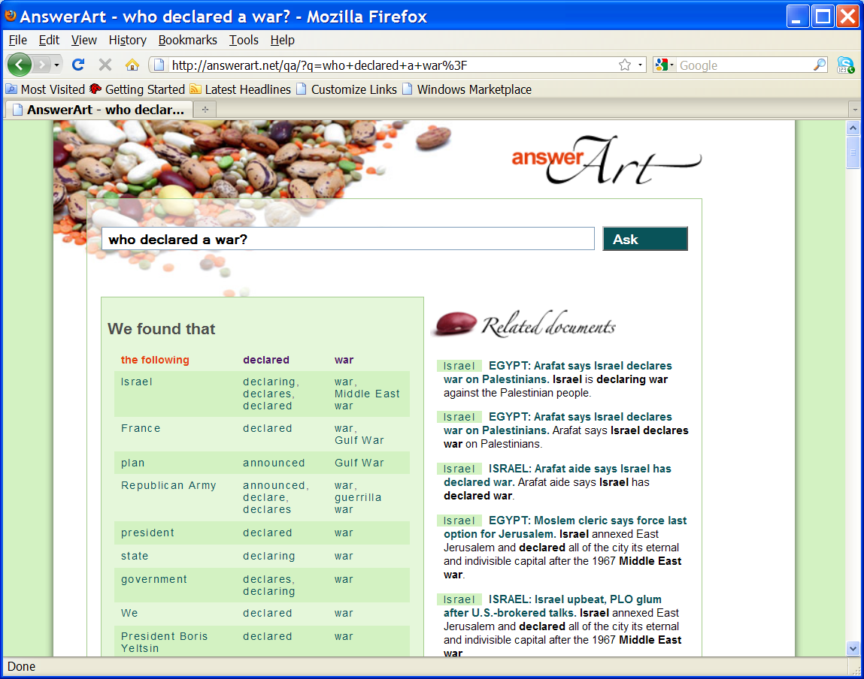
…result set is set of mentions of potential answers

Slide 46
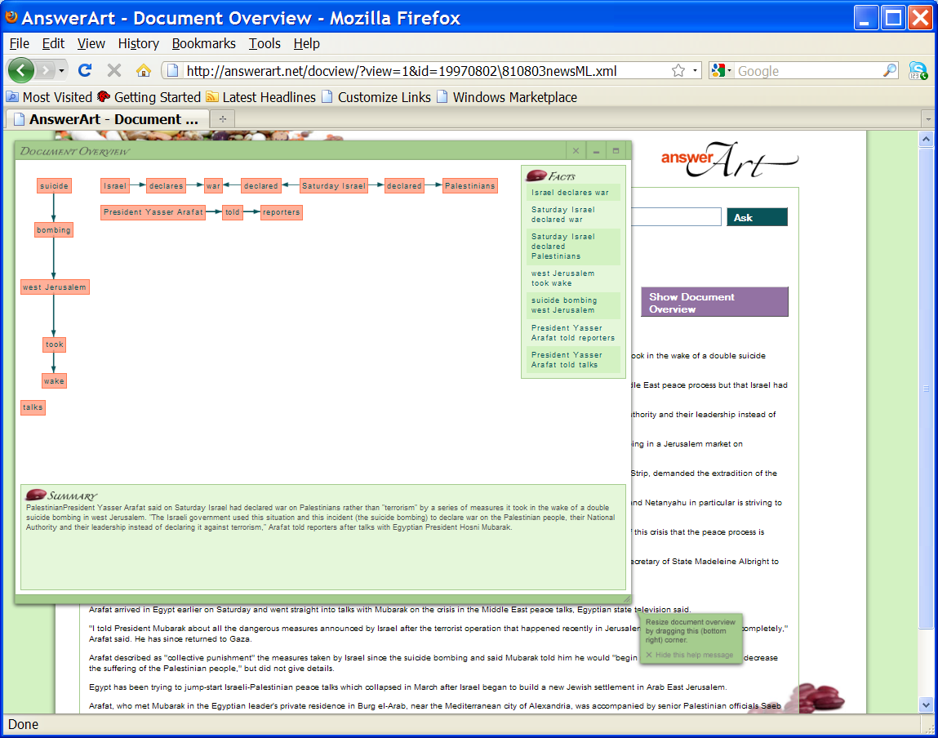
Document browser with summarization

Slide 47
Cyc Knowledge Base and Reasoning

Slide 48
The Cyc Ontology
Cyc contains:
15,000 Predicates
300,000 Concepts
3,200,000 Assertions
Represented in:
  First Order Logic
  Higher Order Logic
  Context Logic
  Micro-theories
Thing
Intangible
Thing
Individual
Sets
Relations
Spatial
Thing
Temporal
Thing
Space
Paths
Partially
Tangible
Thing
Time
Spatial
Paths
Logic
Math
Events
Scripts
Physical
Objects
Borders
Geometry
Artifacts
Agents
Living
Things
Materials
Parts
Statics
Movement
Actors
Actions
Organ-
ization
Ecology
Life
Forms
State Change
Dynamics
Plans
Goals
Organizational
Actions
Types of
Organizations
Natural
Geography
Human
Beings
Plants
Physical
Agents
Organizational
Plans
Human
Activities
Human
Organizations
Political
Geography
Human
Artifacts
Human
Anatomy &
Physiology
Animals
Agent
Organizations
Business &
Commerce
Politics
Warfare
Nations
Governments
Geo-Politics
Weather
Products
Devices
Conceptual
Works
Emotion
Perception
Belief
Human
Behavior &
Actions
Social
Behavior
Purchasing
Shopping
Sports
Recreation
Entertainment
Professions
Occupations
Law
Earth &
Solar System
Vehicles
Buildings
Weapons
Mechanical
& Electrical
Devices
Software
Literature
Works of Art
Language
Social
Relations,
Culture
Social
Activities
Transportation
& Logistics
Travel
Communication
Everyday
Living
Business,
Military
Organizations
General Knowledge about Various Domains
Specific data, facts, and observations
Cycorp © 2006
Notes:
48

Slide 49




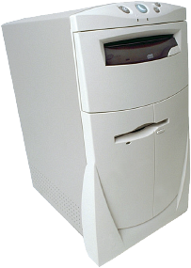


Cyc High-level Architecture
Knowledge
Users
Knowledge
Authors
User Interface
(with Natural Language Dialog)
Other
Applications
Knowledge Entry Tools
Cyc
Reasoning
Modules
Cyc API
Cyc Ontology & Knowledge Base
Interface to
External Data Sources
External Data
Sources
Data
Bases
Web
Pages
Text Sources
Other KBs
Notes:
Cyc is a platform designed to support a wide variety of intelligent applications.
Knowledge entry tools, under development at Cycorp and at client companies, are used by knowledge authors to build out the Cyc KB in domains of interest to some client or customer base.
Applications, written in languages such as Java, interface with Cyc through the Cyc application programming interface, which provides access to hundreds of inference engine, natural language processing and KB indexing functions.
A complete Cyc environment will likely take advantage of Cyc’s ability to connect to external data sources, such as relational databases. After the schema of a data table is described to Cyc (currently by a person) in terms it understands (i.e. the CycL language), Cyc essentially treats the rows of data in the table as if they were additional facts in the knowledge base. In this way, millions upon millions of new facts are made available for use by any Cyc user or any Cyc-powered application.
Cyc is a large system, weighing in at nearly two million lines of code. However, it can run on a desktop machine or on a laptop, taking up less than one gigabyte of disk space and operating well within 256 megabytes of RAM.

Slide 50
Cyc KB Extended w/Domain Knowledge
Thing
Intangible
Thing
Individual
Sets
Relations
Spatial
Thing
Temporal
Thing
General Knowledge about Terrorism:
Terrorist groups are capable of directing assassinations:
(implies
(isa ?GROUP TerroristGroup)
(behaviorCapable ?GROUP AssassinatingSomeone directingAgent))
…
If a terrorist group considers an agent an enemy, that agent is vulnerable to an attack by that group:
(implies
(and
(isa ?GROUP TerroristGroup)
(considersAsEnemy ?GROUP ?TARGET))
(vulnerableTo ?GROUP ?TARGET TerroristAttack))
Space
Paths
Partially
Tangible
Thing
Time
Spatial
Paths
Logic
Math
Events
Scripts
Physical
Objects
Borders
Geometry
Artifacts
Agents
Living
Things
Materials
Parts
Statics
Movement
Actors
Actions
Organ-
ization
Ecology
Life
Forms
State Change
Dynamics
Plans
Goals
Organizational
Actions
Types of
Organizations
Natural
Geography
Human
Beings
Plants
Physical
Agents
Organizational
Plans
Human
Activities
Human
Organizations
Political
Geography
Human
Artifacts
Human
Anatomy &
Physiology
Animals
Agent
Organizations
Business &
Commerce
Politics
Warfare
Nations
Governments
Geo-Politics
Weather
Products
Devices
Conceptual
Works
Emotion
Perception
Belief
Human
Behavior &
Actions
Social
Behavior
Purchasing
Shopping
Sports
Recreation
Entertainment
Professions
Occupations
Law
Earth &
Solar System
Vehicles
Buildings
Weapons
Mechanical
& Electrical
Devices
Software
Literature
Works of Art
Language
Social
Relations,
Culture
Social
Activities
Transportation
& Logistics
Travel
Communication
Everyday
Living
Business,
Military
Organizations
General Knowledge about Terrorism
Specific data, facts, and observations
about terrorist groups and activities

Slide 51
Cyc KB Extended w/Domain Knowledge
Thing
Intangible
Thing
Individual
Sets
Relations
Spatial
Thing
Temporal
Thing
Space
Paths
Partially
Tangible
Thing
Time
Events
Scripts
Specific Facts about Al Qaida:
(basedInRegion AlQaida Afghanistan) Al-Qaida is based in Afghanistan.
(hasBeliefSystems AlQaida IslamicFundamentalistBeliefs) Al-Qaida has Islamic fundamentalist beliefs.
(hasLeaders AlQaida OsamaBinLaden) Al-Qaida is led by Osama bin Laden.
…
(affiliatedWith AlQaida AlQudsMosqueOrganization) Al-Qaida is affiliated with the Al Quds Mosque.
(affiliatedWith AlQaida SudaneseIntelligenceService) Al-Qaida is affiliated with the Sudanese Intell Service
…
(sponsors AlQaida HarakatUlAnsar) Al-Qaida sponsors Harakat ul-Ansar.
(sponsors AlQaida LaskarJihad) Al-Qaida sponsors Laskar Jihad.
…
(performedBy EmbassyBombingInNairobi AlQaida) Al-Qaida bombed the Embassy in Nairobi.
(performedBy EmbassyBombingInTanzania AlQaida) Al-Qaida bombed the Embassy in Tanzania.
Spatial
Paths
Logic
Math
Physical
Objects
Borders
Geometry
Artifacts
Agents
Living
Things
Materials
Parts
Statics
Movement
Actors
Actions
Organ-
ization
Ecology
Life
Forms
State Change
Dynamics
Plans
Goals
Organizational
Actions
Types of
Organizations
Natural
Geography
Human
Beings
Plants
Physical
Agents
Organizational
Plans
Human
Activities
Human
Organizations
Political
Geography
Human
Artifacts
Human
Anatomy &
Physiology
Animals
Agent
Organizations
Business &
Commerce
Politics
Warfare
Nations
Governments
Geo-Politics
Weather
Products
Devices
Conceptual
Works
Emotion
Perception
Belief
Human
Behavior &
Actions
Social
Behavior
Purchasing
Shopping
Sports
Recreation
Entertainment
Professions
Occupations
Law
Earth &
Solar System
Vehicles
Buildings
Weapons
Mechanical
& Electrical
Devices
Software
Literature
Works of Art
Language
Social
Relations,
Culture
Social
Activities
Transportation
& Logistics
Travel
Communication
Everyday
Living
Business,
Military
Organizations
General Knowledge about Terrorism
Specific data, facts, and observations
about terrorist groups and activities

Slide 52
Example of automatic translating text into Cyc Logic
Source: “Galileo Galilei was an Italian physicist and astronomer.”
Learn Logic:(#$and (#$isa #$GalileoGalilei #$ItalianPerson)
(#$isa #$GalileoGalilei #$Physicist)
(#$isa #$GalileoGalilei #$Astronomer))
Fact: Galileo was an Italian, a physicist, and an astronomer.
Source: “Galileo was born in Pisa on Feburary 15, 1564.”
Learn Logic:(#$and (#$birthDate #$GalileoGalilei
(#$DayFn 15
(#$MonthFn #$February
(#$YearFn 1564))))
(#$birthPlace #$GalileoGalilei #$CityOfPisaItaly))
Fact: Galileo was born on February 15, 1564 and he was born in Pisa.
Source: “Albert Einstein was born in 1879 in Ulm, Germany.”
Learn Logic: (#$birthDate #$AlbertEinstein (#$YearFn 1879))
Fact: Albert Einstein was born in 1879.

Slide 53
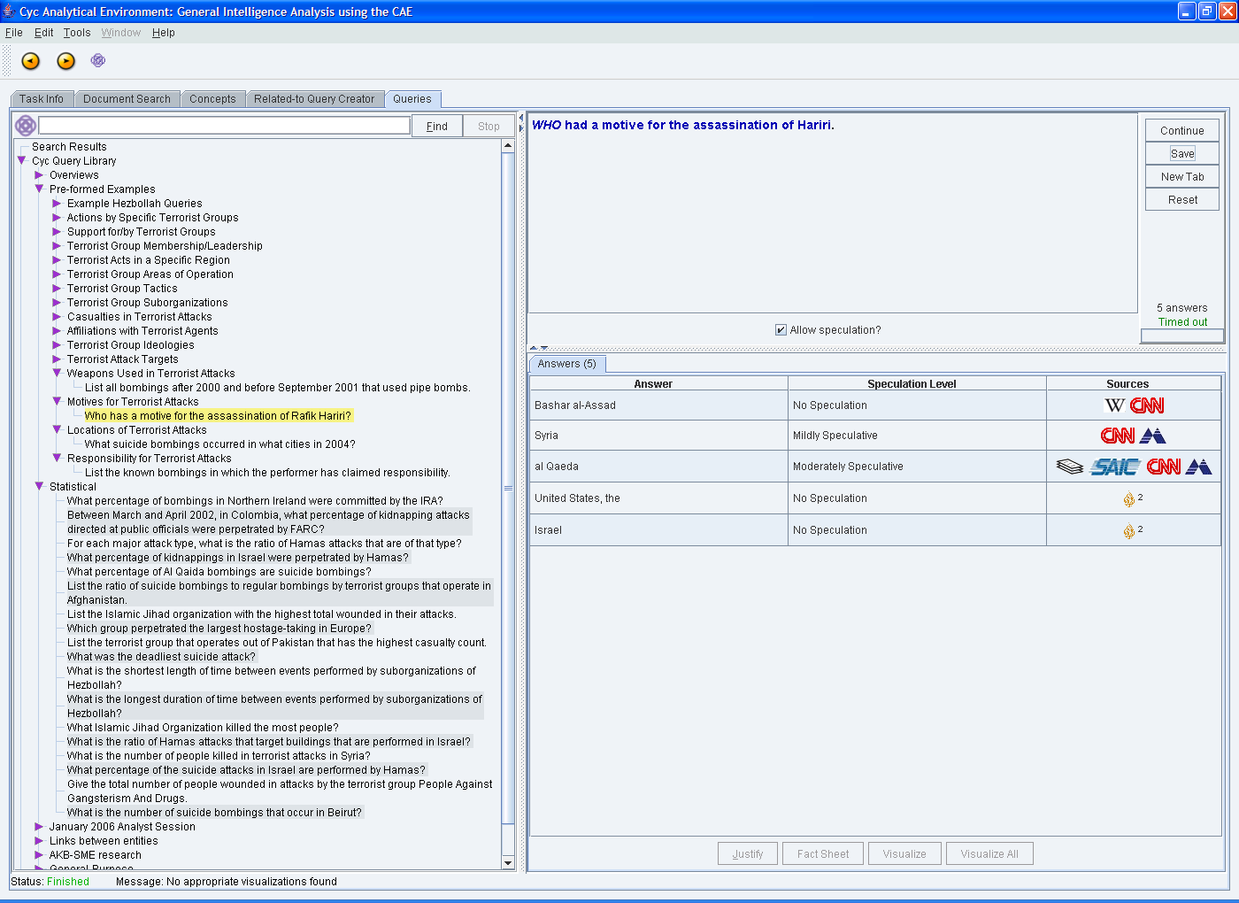
Cyc’s front-end: “Cyc Analytic Environment” – querying (1/2)
Text query
Query (semi) automatically
translated in the
First Order Logic
Who has a motive for the assassination of Rafik Hariri?
Answers to the query

Slide 54
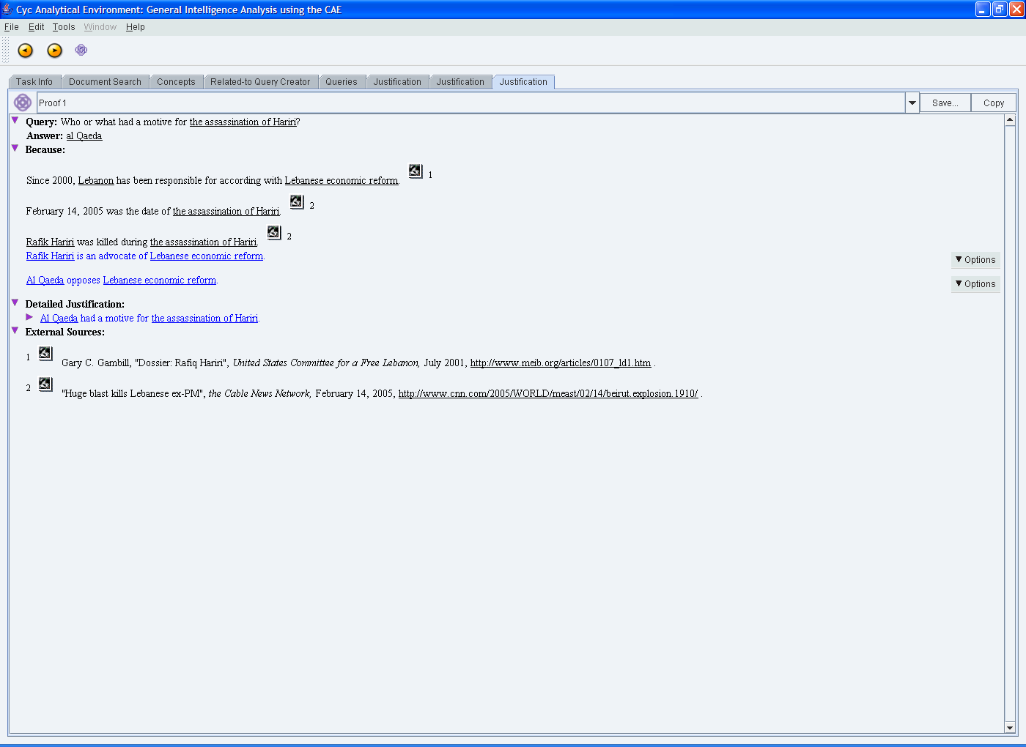
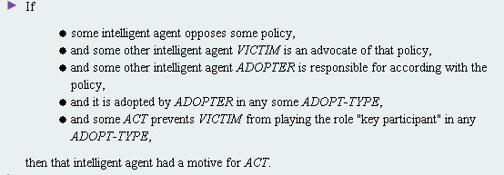
Cyc’s front-end: “Cyc Analytic Environment” – justification (2/2)
Query & Answer
Justification
Sources for
Reasoning and
Justification

Slide 55
Further references…

Slide 56





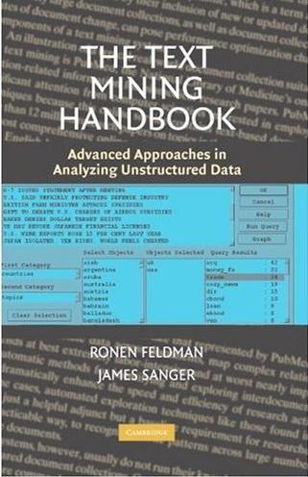
References to some Text-Mining books

Slide 57


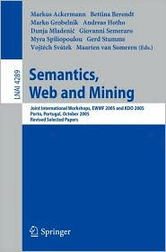




Books on Semantic Technologies

Slide 58
References to the main conferences
Information Retrieval:
  SIGIR, ECIR
Machine Learning/Data Mining:
  ICML, ECML/PKDD, KDD, ICDM, SDM
Computational Linguistics:
  ACL, EACL, NAACL
Semantic Web:
  ISWC, ESWC, ASWC

Slide 59
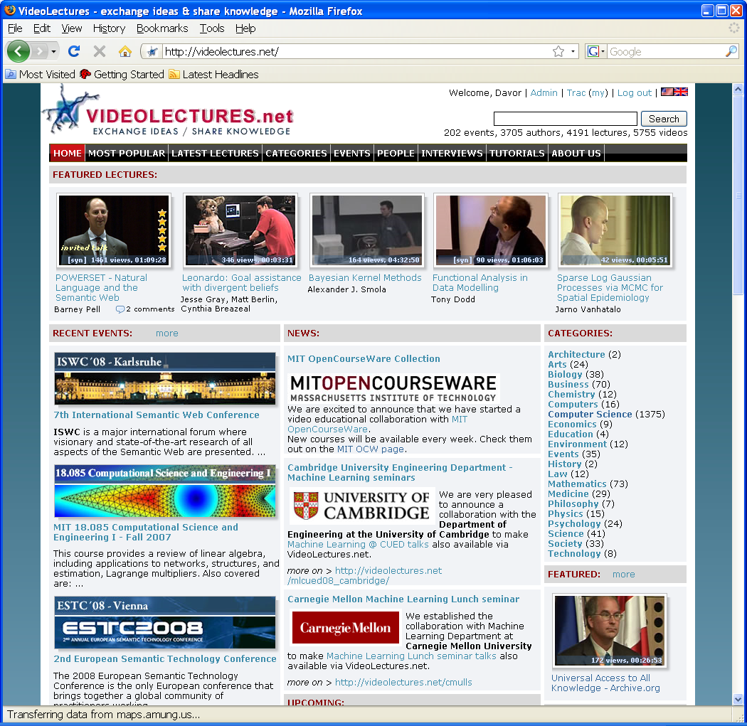
Videos on Text and Semantic Technologies http://videolectures.net/Top/Computer_Science/Semantic_Web/
Recorded tutorials, workshops, conferences, summer schools available from http://videolectures.net

