Slide 1
Comparison of Ontology Reasoning Systems Using Custom Rules
Hui Shi, Kurt Maly, Steven Zeil, and Mohammad Zubair
Contact: maly@cs.odu.edu

Slide 2
Outline
Introduction
What are we evaluating
What is the approach we are taking?
Background
Existing benchmarks
Ontology systems supporting custom rules
Experimental design
Data and custom rules
Metrics and evaluation procedure
Results
Setup time
Query processing
Transitive rule
Caching
Conclusions

Slide 3
Introduction - Problem
Problem
Scalability issues in the context of a question/answer system (called ScienceWeb) in the domain of a knowledge base of science information that has been harvested from the web
ScienceWeb is being built using ontologies, reasoning systems and custom based rules for the reasoning system
Approach
Use existing benchmarks extended with
Custom inference rules
Generate more realistic data
In the ScienceWeb environment

Slide 4
Background
Existing semantic application: question/answer systems
AquaLog, QuestIO, QUICK - natural language input
Semantic Web
Resource Description Framework(RDF)
RDF schemas
Web Ontology Language (OWL) for specific knowledge domains
SPARQL query language for RDF
SWRL web rule language
Reasoning systems
Jena proprietary Jena rules
Pellet and KANON supporting SWRL
ORACLE 11g
OWLIM

Slide 5
Background
Existing performance studies on OWL based reasoning systems only on native rule sets
Varying complexity of Abox and Tbox
Tbox (contains the axioms defining the classes and relations in an ontology)
Abox (assertions about the individuals in the domain)
Existing benchmarks to generate ontologies
Leigh University Benchmark(LUBM)
University Ontology Benchmark (UOBM) and extension of LUBM

Slide 6
Background – Ontologies with custom rule support
Jena: in memory and persistent store, SPARQL, forward chain and backward chain
Pellet: open source, descriptive logic, SQRL
KAON2: free, SWRL,F-logic, SPARQL
Oracle 11g: native inference using database, forward chaining, OWL
OWLIM: OWL, rules and axiomatic triples

Slide 7
General comparison among ontology reasoning systems

Slide 8
Experimental Design - ontology
Baseline: LUBM
ScienceWeb: use own data generator for ontology instance data (UnivGenerator)
Classes are more detailed
Data are more realistic (e.g., faculty with advisors in different universities, co-authors at different universities)

Slide 9
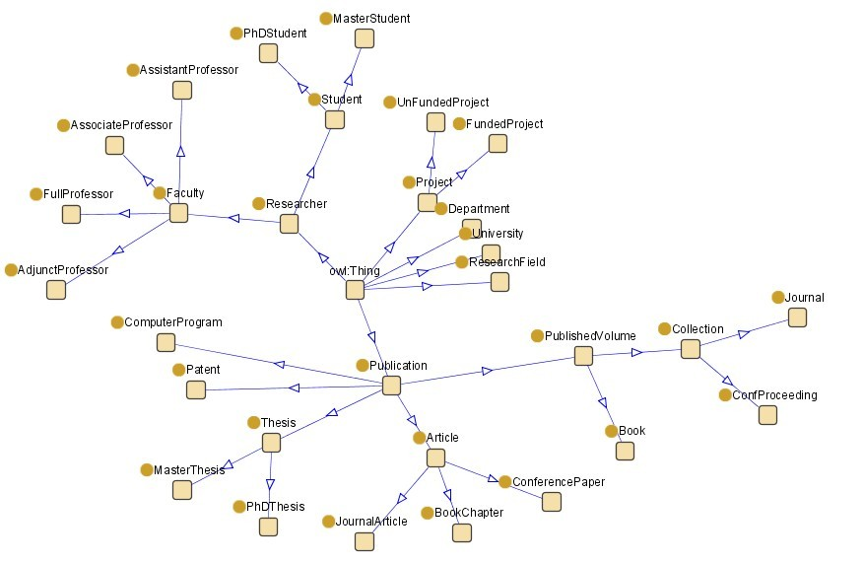
Class tree of research community ontology.

Slide 10
Size range of datasets (in triples)

Slide 11
Experimental Design – Rule Set

Slide 12
Rule set 1: Co-author
authorOf(?x, ?p) authorOf(?y, ?p) coAuthor(?x, ?y)
Rule set 2: validated Co-author authorOf(?x, ?p)
authorOf(?y, ?p) notEqual(?x, ?y) coAuthor(?x, ?y)
Rule set 3: Research ancestor (transitive)
advisorOf(?x, ?y) ⟹ researchAncestor(?x, ?y)
researchAncestor(?x, ?y) researchAncestor(?y, ?z)
⟹ researchAncestor(?x, ?z)

Slide 13
Rule set 4: Distinguished advisor (recursive)
advisorOf(?x,?y) advisorOf(?x,?z) notEqual(?y,?z)
worksFor(?x,?u)
⟹ distinguishAdvisor(?x, ?u)
advisorOf(?x,?y) distinguishAdvisor(?y,?u) worksFor(?x,?d) distinguishAdvisor(?x, ?d)
Rule set 5: combination of above 4 rule sets.

Slide 14
Jena encoding: @include <OWL>.
[rule1: (?x uni:authorOf ?p) (?y uni:authorOf ?p) notEqual(?x,?y) ->(?x uni:coAuthor ?y)]
[rule2: (?x uni:advisorOf ?y) -> (?x uni:researchAncestor ?y)]
[rule3: (?x uni:researchAncestor ?y)(?y uni:researchAncestor ?z) ->(?x uni:researchAncestor ?z)]
[rule4: (?x uni:advisorOf ?y) (?x uni:advisorOf ?z notEqual(?y,?z) (?x uni:worksFor ?u) -> (?x uni:distinguishAdvisor ?u)]
[rule5: (?x uni:advisorOf ?y) (?y uni:distinguishAdvisor ?u) (?x uni:worksFor ?d) -> (?x uni:distinguishAdvisor ?d)]

Slide 15
In SWRL these rules are less compact. Rule 1:
<swrl:Variable rdf:about="#x"/>
<swrl:Variable rdf:about="#y"/>
<swrl:Variable rdf:about="#p"/>
<swrl:Imp rdf:about="rule1">
<swrl:head rdf:parseType="Collection">
<swrl:IndividualPropertyAtom>
<swrl:propertyPredicate rdf:resource="#coAuthor"/>
<swrl:argument1 rdf:resource="#x"/>
<swrl:argument2 rdf:resource="#y"/>
</swrl:IndividualPropertyAtom>
</swrl:head> ……

Slide 16
Query in SPARQL notation:
Query 1: Co-author
PREFIX uni:<http://www.owl-ontologies.com/OntologyUniversityResearchModel.owl#> SELECT ?x ?y
WHERE {?x uni:coAuthor ?y. ?x uni:hasName \"FullProfessor0_d0_u0\" }

Slide 17
Query 2: Research ancestor
PREFIX uni:<http://www.owl-ontologies.com/OntologyUniversityResearchModel.owl#>
SELECT ?x ?y
WHERE {?x uni:researchAncestor ?y. ?x uni:hasName \"FullProfessor0_d0_u0\" };

Slide 18
Query 3: Distinguished advisor
PREFIX uni:<http://www.owl-ontologies.com/OntologyUniversityResearchModel.owl#>
SELECT ?x ?y
WHERE {?x uni:distinguishAdvisor ?y. ?y uni:hasTitle \"department0u0\" };

Slide 19
Experimental Design - Metrics
Setup time
This stage includes loading and preprocessing time before any query can be made
Query processing time
This stage starts with parsing and executing the query and ends when all the results have been saved in the result set.

Slide 20
Experimental Design - Procedure
Scale with the size the instance data
Scale with respect to the complexity of reasoning
Transitive chain
Caching effect
Realism of model (ScienceWeb vs LUBM)

Slide 21
Results – Setup time

Slide 22
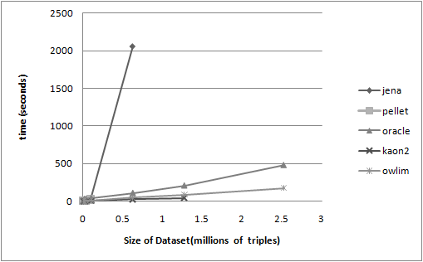
Setup time of rule set 1 for LUBM dataset

Slide 23
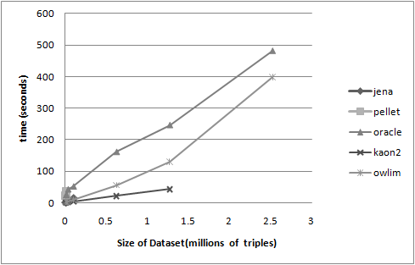
Setup time of rule set 4 for LUBM dataset

Slide 24
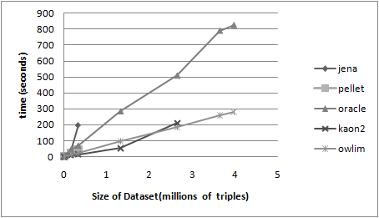
Setup time of rule set 1 for ScienceWeb dataset

Slide 25
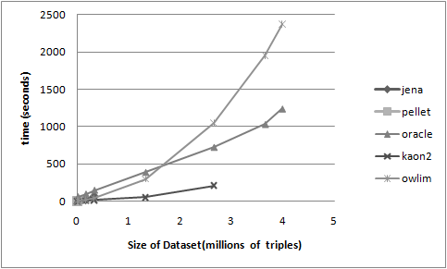
Setup time of rule set 4 for ScienceWeb dataset

Slide 26
Results – Setup time
Some systems have no data points because of size of Abox (Jena, Pellet, KAON2 load into memory for inferencing)
For small(<2 Million) KAON2 best
Oracle and OWLIM scale to 4 million triples with no problem; Oracle scales best
Great variation with different rule sets
OWLIM not good on rule set 4 for ScienceWeb(more triples in Abox than LUBM) as compared to Oracle
Oracle not good on rule set 2 as it needs to set up “filter” to implement “notEqual”

Slide 27
Results – Query Processing

Slide 28
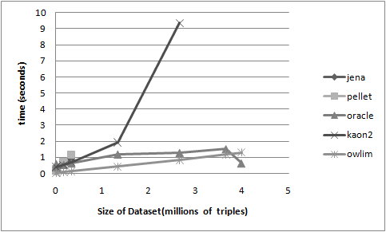
Query processing time of query 1 for ScienceWeb dataset

Slide 29
Results – Query Processing
OWLIM best for all but largest (4 Million) triple set
Oracle best for largest set
Query returned in seconds
Setup time can take hours

Slide 30
Results – Caching Effect
Caching ratio:
first query processing time /average over next ten identical queries
OWLIM little effect
In other systems effect becomes weaker as the size of dataset grows

Slide 31
Caching ratios between processing time of single query and average processing time on ScienceWeb ontology for query 1

Slide 32
Results – Transitive Rule
created a group of separate instance files containing different number of individuals that are related via the transitive rule in rule set 3

Slide 33
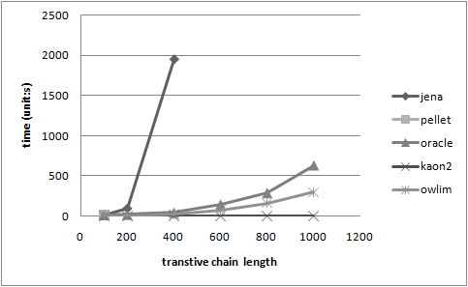
Setup time for transitive rule

Slide 34
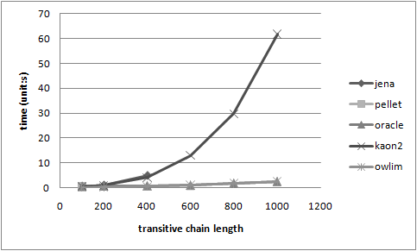
Query processing time after inference over transitive rule

Slide 35
Results – Transitive Rule
Pellet only provides the results before time-out when the length of transitive chain is 100
Jena’s performance degrades badly when the length is more than 200
Only KAON2, OWLIM and Oracle 11g could complete inference and querying on long transitive chains

Slide 36
Conclusions
When more realistic models (ScienceWeb) than provided by LUBM are used, serious issues arise when the size approaches million of triplets
OWLIM and Oracle offer the best scalability for the kinds of datasets anticipated for ScienceWeb
heavy front-loading of the inferencing costs by pre-computing the entailed relationships at set-up time
negative implications for evolving systems
Real-time queries over large triplet spaces will have to be limited in their scope
How we can specify what can be asked within a real-time system? We do not know yet.

